Slide 1

REACHING
NON-SPIRITUAL
AUDIENCES
INFINITE POSSIBILITIES:
TRAIN THE TRAINER CONFRENCE

Slide 2








Notes:
Who is David Casti?
Certified IP Trainer and management consultant.
Customers include many household names:
Time Warner, Comcast, British Telecom
US Departments of State, Energy, and Treasury

Slide 3
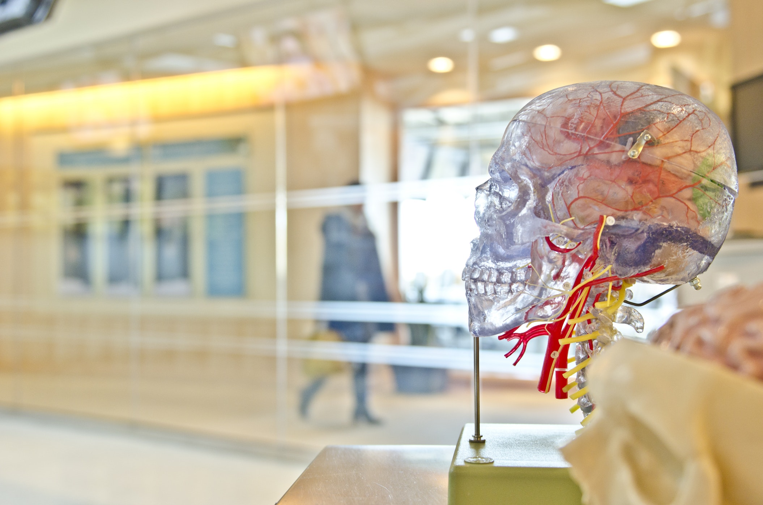
THIS IS UNCONTROVERSIAL, SETTLED SCIENCE
“
PLEASE SEND ME YOUR QUESTIONS
DAVID@CASTI.COM
Notes:
We will not be breaking any new scientific ground tonight. Everything discussed is uncontroversial, settled science.
Contact me to get a “handout copy” of today’s presentation
Please send me your questions at david@casti.com

Slide 4

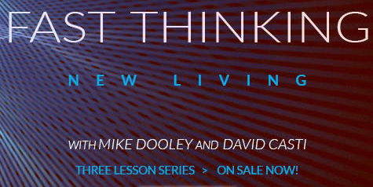
“
ADDITIONAL
RESOURCES
AVAILABLE
Notes:
Because we have a lot of material, I am going to do more “telling” than “explaining”, and we’ve taken all the exercises out of the presentation.
Everything I talk about is covered in detail in the bibliography at the back of this presentation.
Also, we have a longer, online course you can sign up for if you are interested

Slide 5

NON-SPIRITUAL
AUDIENCES
WHO ARE THEY? AND WHY DO I CARE?

Slide 6

ARE YOU SAYING THAT IP IS NOT SPIRITUAL
NO
Notes:
No.
As Infinite Possibilities (“IP”) trainers, we are looking for ways to help people improve their lives, regardless of their background.
Many audiences will be comfortable with discussions involving magic, miracles, God, and other “spiritual” concepts.

Slide 7


LET’S NAME
SOME AUDIENCES YOU WILL MEET WHO CAN’T HEAR SPIRITUAL LANGUAGE
Notes:
The Abused
Some people have been mistreated in the name of spirituality, often by others in position of great authority such as their own parents.
These people generally leave when spirituality comes

Slide 8

THE ABUSED
PEOPLE WHO HAVE BEEN MISTREATED IN THE NAME OF SPIRITUALITY
Notes:
The Abused
Some people have been mistreated in the name of spirituality, often by others in position of great authority such as their own parents.
These people generally leave when spirituality comes up.

Slide 9

THE
NON-
ALIGNED
WHO GENERALLY DISCREDIT YOU
WHEN SPIRITUALITY COMES UP
Notes:
The Non-Aligned
Our pluralistic compromise is to generally exclude spirituality from places where attendance is compulsory such as school and work.
For non-aligned people, spirituality is closely connected to superstition and pseudoscience.
These people generally discredit you when spirituality comes up

Slide 10

THE
HIGHLY
DOGMATIC
WHO GENERALLY ARGUE WITH YOU
WHEN SPIRITUALITY COMES UP
Notes:
The Highly Dogmatic
Although Mike is very clear that IP is not a religion, it does make specific claims that challenge deeply-held beliefs of many religions.
These people generally argue with you when spirituality comes up

Slide 11


A BONUS TO THE
NON-SPIRITUAL APPROACH
IP HELPS YOU ACHIEVE YOUR GOALS
Notes:
IP can be viewed purely practically, as technology that can be used to help you achieve your goals.
By reorienting the discussion away from metaphysical models of existence and towards practical scientific principals, the course becomes about how to make your life the best it can be – whatever that means to you.
Nazis, AIDS, evil and atrocities of every kind are now out-of-scope for our class.
The focus of class becomes about making your life the best it can be, not explaining the history of the world or human suffering.

Slide 12

THE
HUMAN BRAIN
1
THE MISSING MANUAL

Slide 13
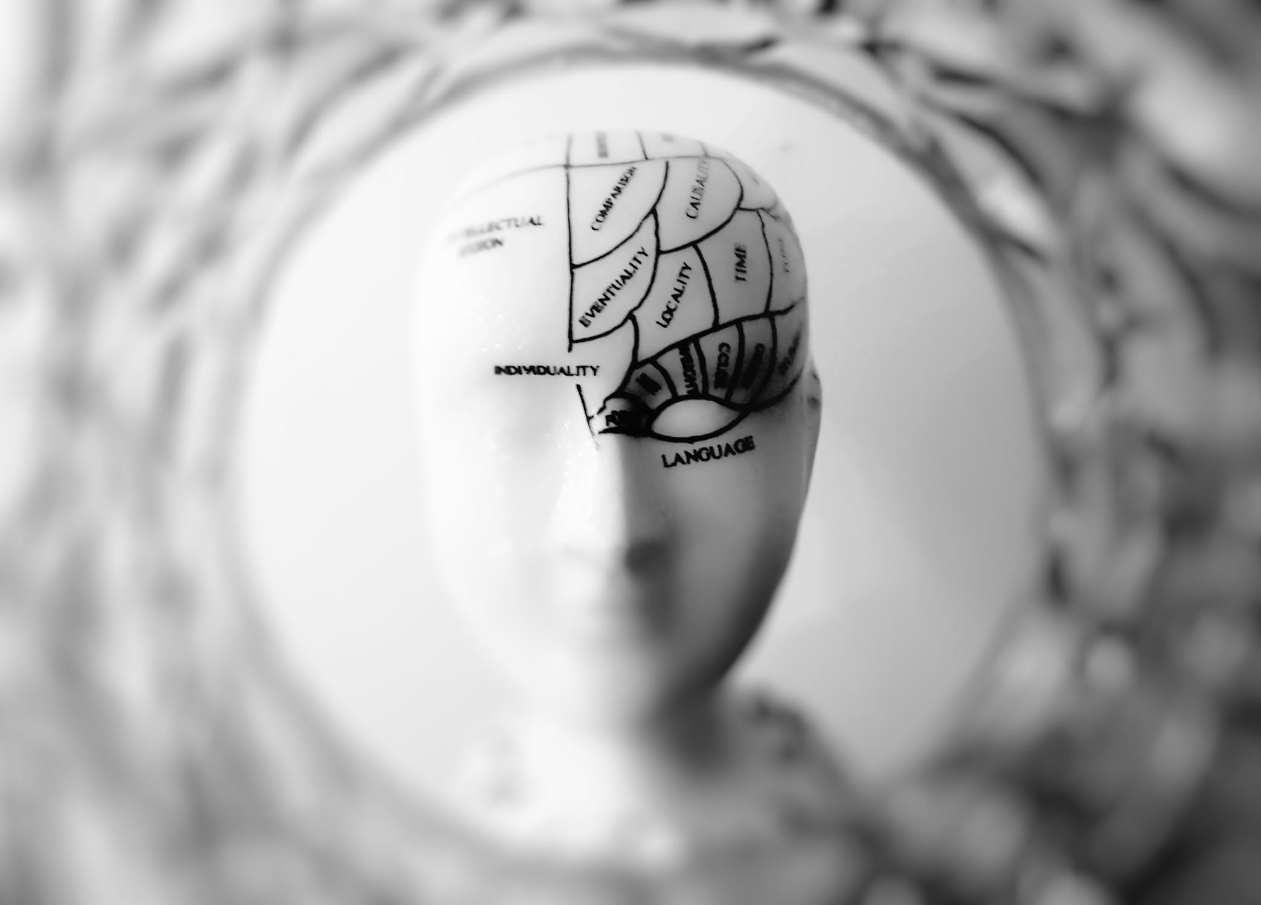
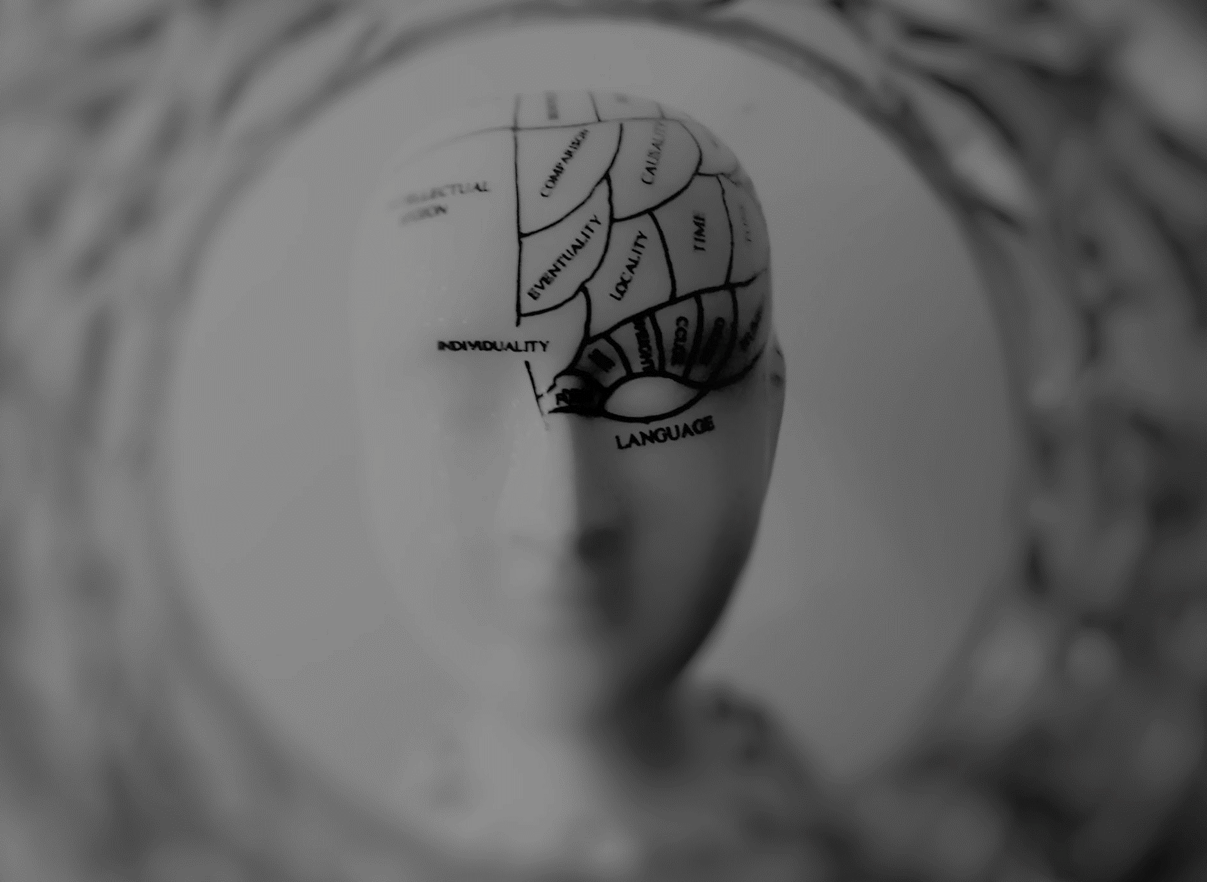
ASSOCIATION
IS THE MOST BASIC PRINCIPLE
CONNECTIONS BETWEEN IDEAS
& EXPERIENCES
Notes:
Association is any connection between any two ideas or experiences.

Slide 14

let's
TRY AN
EXAMPLE
WHAT COMES TO MIND WHEN I SAY THE WORD
“LION”
Notes:
Prepare to snap your fingers.
Look at your thumb, feel it against your finger.
Now keep watching as you snap and hear the noise.
Notice that you experienced all three senses simultaneously:
The feel of your thumb against your fingers
The sound of the snap
The sight of your fingers sliding over each other
These events were synchronized in time from your point of view!

Slide 15


A CAT?
THE ZOO?
A SAFARI? the ZODIAC? The LION KING?
“
THIS IS AN EXAMPLE OF A TRIGGER
Notes:
Prepare to snap your fingers.
Look at your thumb, feel it against your finger.
Now keep watching as you snap and hear the noise.
Notice that you experienced all three senses simultaneously:
The feel of your thumb against your fingers
The sound of the snap
The sight of your fingers sliding over each other
These events were synchronized in time from your point of view!

Slide 16
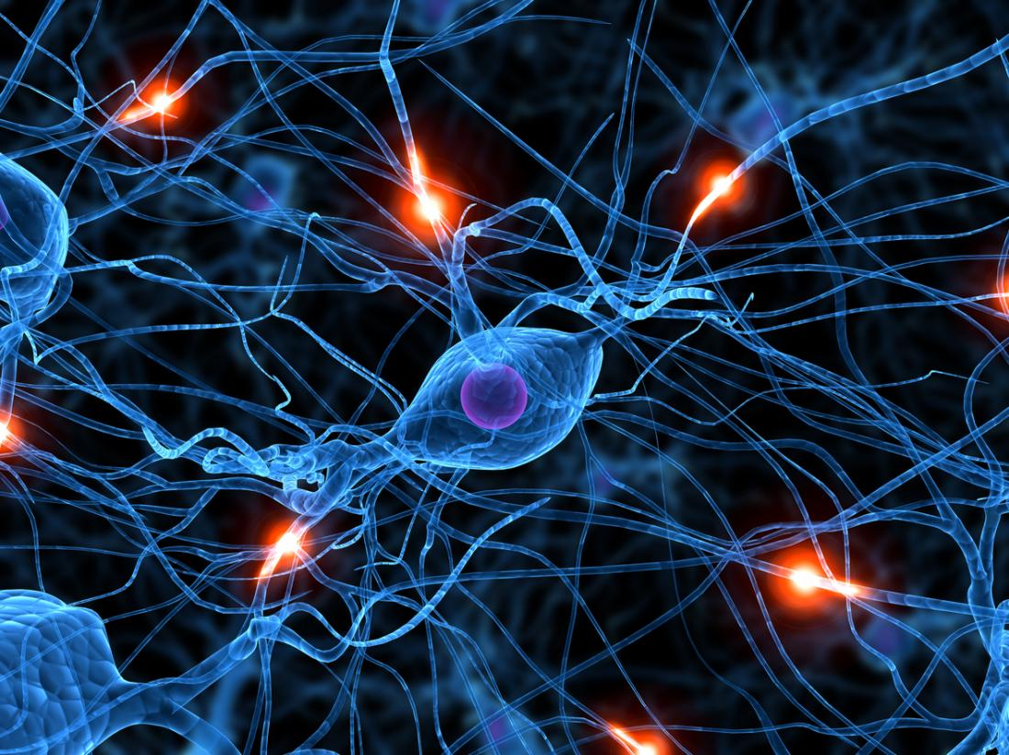
BUT THIS IS JUST THE BEGINNING
OUR NERVOUS SYSTEM IS FILTERING CONTINUOUSLY
Notes:
Triggers in the form of sensory stimulation are raining down on you continuously.
Our nervous system captures a staggering amount of data and almost all of it is screened out before it reaches our consciousness.
BUT!...

Slide 17


TRANSFORMS
MODIFIES
ALTERS
OUR NERVOUS SYSTEM HAS SILENT EDITING CAPABILITIES.
Notes:
In addition to deleting data, our nervous system has a silent editing capability that would put any Hollywood special effects studio to shame.

Slide 18

AN
EDITING EXAMPLE
SNAP YOUR
FINGERS!
SYNCHRONIZED,
RIGHT?
Notes:
Prepare to snap your fingers.
Look at your thumb, feel it against your finger.
Now keep watching as you snap and hear the noise.
Notice that you experienced all three senses simultaneously:
The feel of your thumb against your fingers
The sound of the snap
The sight of your fingers sliding over each other
These events were synchronized in time from your point of view!

Slide 19





IT WASN’T SYNCHRONIZED AT ALL
200 MPH
700 MPH
670 MIL MPH
Notes:
The real story is that information from each of those senses arrived to your brain at very different times:
The nerve impulse traveled along your arm and into your brain at 200 mph,
The sound traveled to each of yours ears at 700 mph, and
The light traveled to your retina at 670 million mph!
As a result, data from your senses about your finger snap was reported to your brain more than 1/20th of a second apart
Your brain edited everything back together so it appears to you that all three things happened at the same time.
1/20th of a second doesn’t sound like much, but …
if you were watching a movie with a black frame every 20th of a second it would blink
if the sound of my voice was 1/20th of a second behind my lips moving it would be so disturbing you would look away.
Your brain typically exercises editing over events up to 1/10th of a second apart.

Slide 20


OUR NERVOUS SYSTEM HAS A SILENT EDITING CAPABILITY
Notes:
In addition to deleting data, our nervous system has a silent editing capability that would put any Hollywood special effects studio to shame.
The Most Important Point About Your Brain’s Awesome Editing Powers is that You have no awareness that any editing happened!
Your consciousness simply received a finished picture of reality, completely “cleaned up” and ready to act upon!
There is no sensation to signal anything has been edited at all.

Slide 21
YOUR TWO
THINKING
SYSTEMS
INTRODUCING
2

Slide 22


FAST
SLOW
Notes:
Nobel prize winning psychologist Daniel Kahneman suggests one way to talk about this process. He says we have two different thinking systems: one “fast” and one “slow”.
These thinking systems have very different features and functions, both completely critical.

Slide 23



FAST
THINKING
CREATES OUR VIEW OF THE WORLD:
SEARCH & FETCH
ANCIENT
AUTOMATIC
Notes:
“Fast Thinking” is the part of our brain that processes incoming information, and associates it to everything we already know. It creates our view of the world and takes many short-cuts, because it doesn’t have a lot of time.

Slide 24
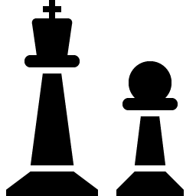


SLOW
THINKING
IS OUR EXECUTIVE FUNCTION:
ANALYZE & PLAN
RECENT
INTENTIONAL
Notes:
“Slow Thinking” is our “executive function” – the part that analyzes and makes tough decisions, sets goals and priorities. It is the part we normally think of as “us”, and everything it does is influenced by our Fast Thinking.

Slide 25
FAST THINKING, CLOSE UP
ANNE APPROACHED
THE BANK
What image came to mind?
Notes:
Let’s now look closely at one aspect of Fast Thinking using an exercise. I am going to read a sentence out loud and you will see a picture matching that sentence appear in your mind.
“Anne approached the bank.” Did you see…

Slide 26


THIS?
THAT?
Notes:
Note that whichever image you saw, you did not see the other one at the same time!
You did not have the sense that you were seeing “only one” of many possible images. The image which first appeared stood alone.
You did not doubt or question your interpretation. The images which appear are fully trusted.
You did not get mixed up into images competing with each other, like a woman holding a handbag in a boat going towards a building. The images which appear are always internally consistent. Fast Thinking always produces consistent world views.

Slide 27

BUT FAST THINKING IS NOT JUST
FOR WORDS
What do you see when you see this image?
Notes:
Consider the following image…

Slide 28

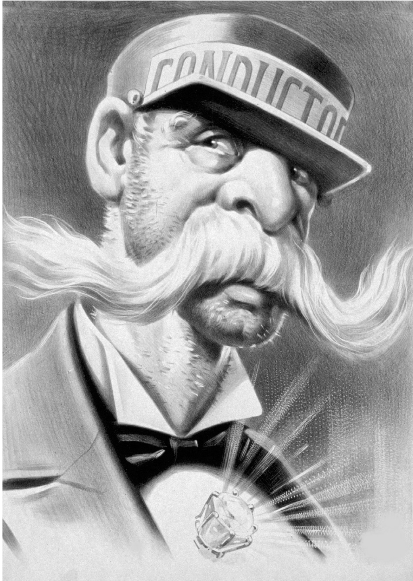

YOU CAN SEE THEM ALL. BUT NOT AT THE SAME TIME!
Notes:
One way to understand why Fast Thinking can not hold a contradiction is to imagine that information gets “used up” as your world view is constructed.
Once information has been assigned one meaning, it can not take on a contradictory meaning.
You can flip back and forth.
You can intellectually know all images are valid interpretations.
You can not fully see all images at the same time.

Slide 29

WHAT’S THE DIFFERENCE
?
BETWEEN FAST AND SLOW THINKING
Fast thinking doesn't allow for contradictions.
It can only construct one picture at a time!
Notes:
Fast thinking is not able to think a contradiction. This is very important and it is one key reason that IP works.
Fast thinking uses your biological association engine to construct a coherent picture of the world, and it can only construct one picture at a time.

Slide 30
YOUR
FAST THINKING
PROGRAMMING
3

Slide 31

FAST THINKING IS ALWAYS ON
But it’s not always right!
Notes:
Fast thinking is always on. It never stops. You can not turn it off.
Not only is it processing the words you hear people say, but it is processing everything you think, see, hear, do, feel, imagine, dream – everything in your consciousness has been “handled” by Fast Thinking – and comes to your awareness complete with a huge tree of associations.
You do not have conscious control over your Fast Thinking. Even when you know it is giving you incorrect information, you can not stop seeing the illusion. Fast Thinking shapes your entire experience of reality. It really is that powerful.

Slide 32

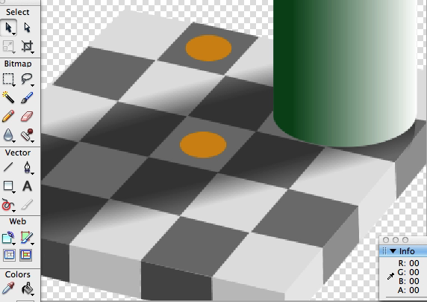
Notes:
Fast thinking is always on. It never stops. You can not turn it off.
Not only is it processing the words you hear people say, but it is processing everything you think, see, hear, do, feel, imagine, dream – everything in your consciousness has been “handled” by Fast Thinking – and comes to your awareness complete with a huge tree of associations.
You do not have conscious control over your Fast Thinking. Even when you know it is giving you incorrect information, you can not stop seeing the illusion. Fast Thinking shapes your entire experience of reality. It really is that powerful.

Slide 33




THERE ARE
MANY TYPES
OF ILLUSIONS
AUDITORY
VISUAL
COGNITIVE
Notes:
Just as there are illusions in your senses, you live in a world filled with invisible cognitive illusions. Sometimes these are called “limiting beliefs”. Discovering your limiting beliefs does nothing to change them. Just as with the checkerboard, you can not consciously control Fast Thinking – and knowing it has made a mistake does not change your honest experience of the world.

Slide 34

YOUR WILLPOWER
WILL ALWAYS
FAIL YOU
Your fast thinking decides what is real and what is not real long before slow thinking ever gets a chance to “decide”
Notes:
How many of you have ever felt like your willpower “let you down”? Like, if you had just “tried harder” you could have done it? I’m here to tell you, those thought that say you didn’t work hard enough or try hard enough or want it bad enough: those thoughts are all wrong. Look at this picture again, closely this time. You can not “will” yourself to see the colors are the same in this picture. You have ancient, automatic, biologically-wired systems that decide what is and is not “real” long before you ever get a chance to “decide” or use your “willpower”. As a result, the world that appears to you is silently and relentlessly shaped by your Fast Thinking. Therefore, taking control of your life requires getting ahead of these automatic processes and learning to reprogram them – so your world ACTUALLY APPEARS DIFFERENTLY TO YOU than it did before. Then willpower won’t even be needed.

Slide 35


FAST
THINKING IS
NOT A JUDGE
Notes:
Fast thinking is not an executive decision-maker, so it doesn’t judge associations.

Slide 36


CONSTRUCTIVE
DESTRUCTIVE
Notes:
Therefore, its associations can be constructive or destructive to your goals.
Your role as the owner of a Fast Thinker is to re-program these associations so constructive ones emerge. This is the main activity of IP.

Slide 37

THE GOOD NEWS?
WE CAN RE-PROGRAM OURSELVES
To reduce the unhelpful associates we’ve made throughout the years. It’s not as difficult as you’d imagine.
Notes:
This is both good news and bad news. It means most of us have accidentally programmed ourselves with all manner of unhelpful associations!

Slide 38

“
LET’S START BY ANCHORING. IT’S A
NEW STARTING POINT
Notes:
Reprogramming begins with “anchoring”. Anchoring is establishing a new starting point for the associations which come next.

Slide 39

FILL IN THE BLANK
SO_P
WASH SO_P
EAT SO_P
Notes:
Reprogramming begins with “anchoring”. Anchoring is establishing a new starting point for the associations which come next.

Slide 40
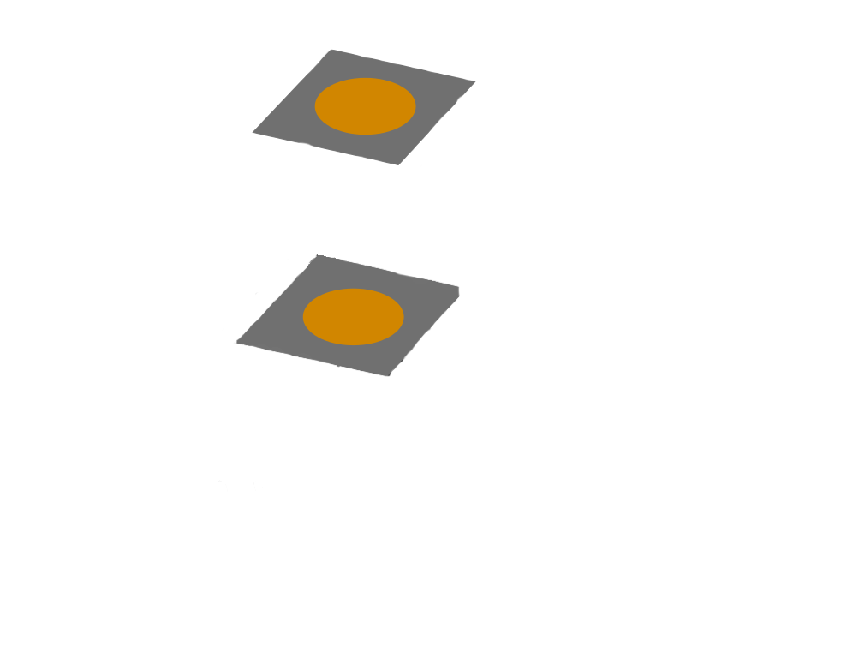
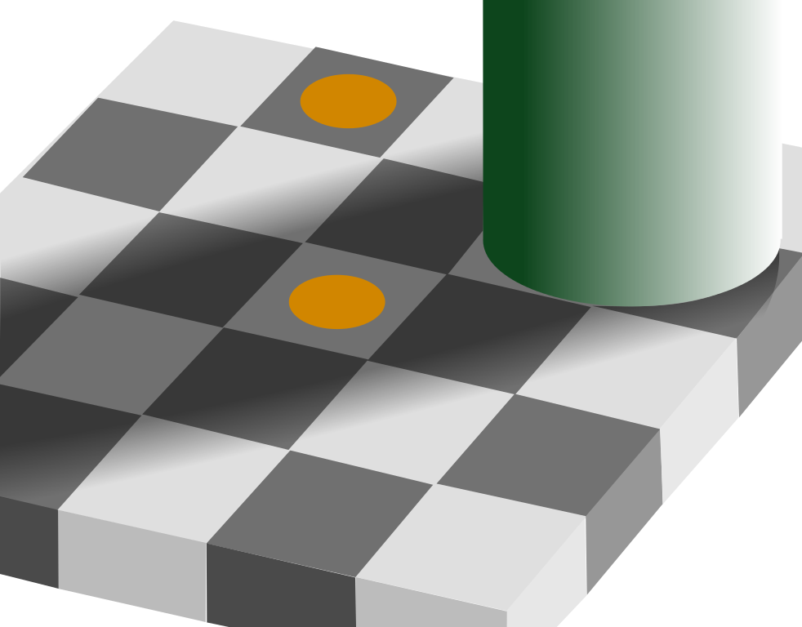
Notes:
http://fahardi.ir/blog/137/09/23/color-illusion/

Slide 41
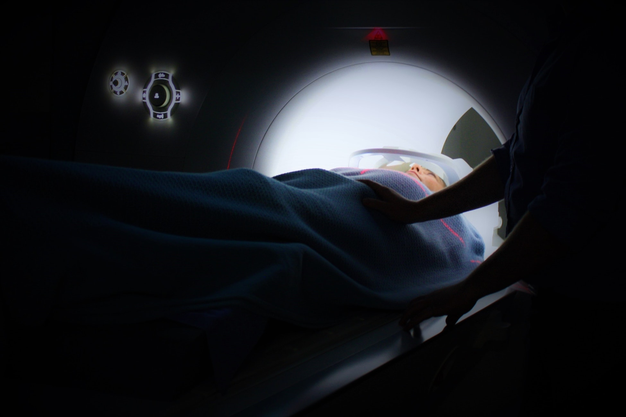


WHAT MAKES
A STRONG ASSOCIATION
?
RECENCY
REPETITION
Notes:
Given incoming information, Fast Thinking searches your neural library for the strongest associations, and generates its picture of the world from them. Associations are stronger when they are:
More recent
This is why anchoring works!
More frequently used / repeated
Engaging more of your senses

Slide 42




AND YOUR 5 SENSES
AKA – “MULTI-MODAL”
Notes:
Given incoming information, Fast Thinking searches your neural library for the strongest associations, and generates its picture of the world from them. Associations are stronger when they are:
More recent
This is why anchoring works!
More frequently used / repeated
Engaging more of your senses

Slide 43

“
AND … MOMENTS OF INTENSITY AND UNUSUAL SITUATIONS
Notes:
Created during a moment of high intensity
More unusual / novel / rare

Slide 44

AFFIRMATIONS
AREN’T MAGIC. SO WHAT ARE THEY?
Notes:
Visualizations and affirmations work by reprogramming Fast Thinking to offer up new associations.
Your best visualizations perfectly match Fast Thinking’s strongest associating rules. They:
Are recent
Are frequently repeated – but not so often as to be ignored
Engage most/all of your senses
Stir up strong emotional intensity
Use imagery and ideas that are unusual / novel / rare
Coincidence?
No! Science.

Slide 45
SEARCH
ENGINE
YOUR “ALWAYS ON”
4
HOW FAST THINKING
PREPARES US FOR LIFE

Slide 46
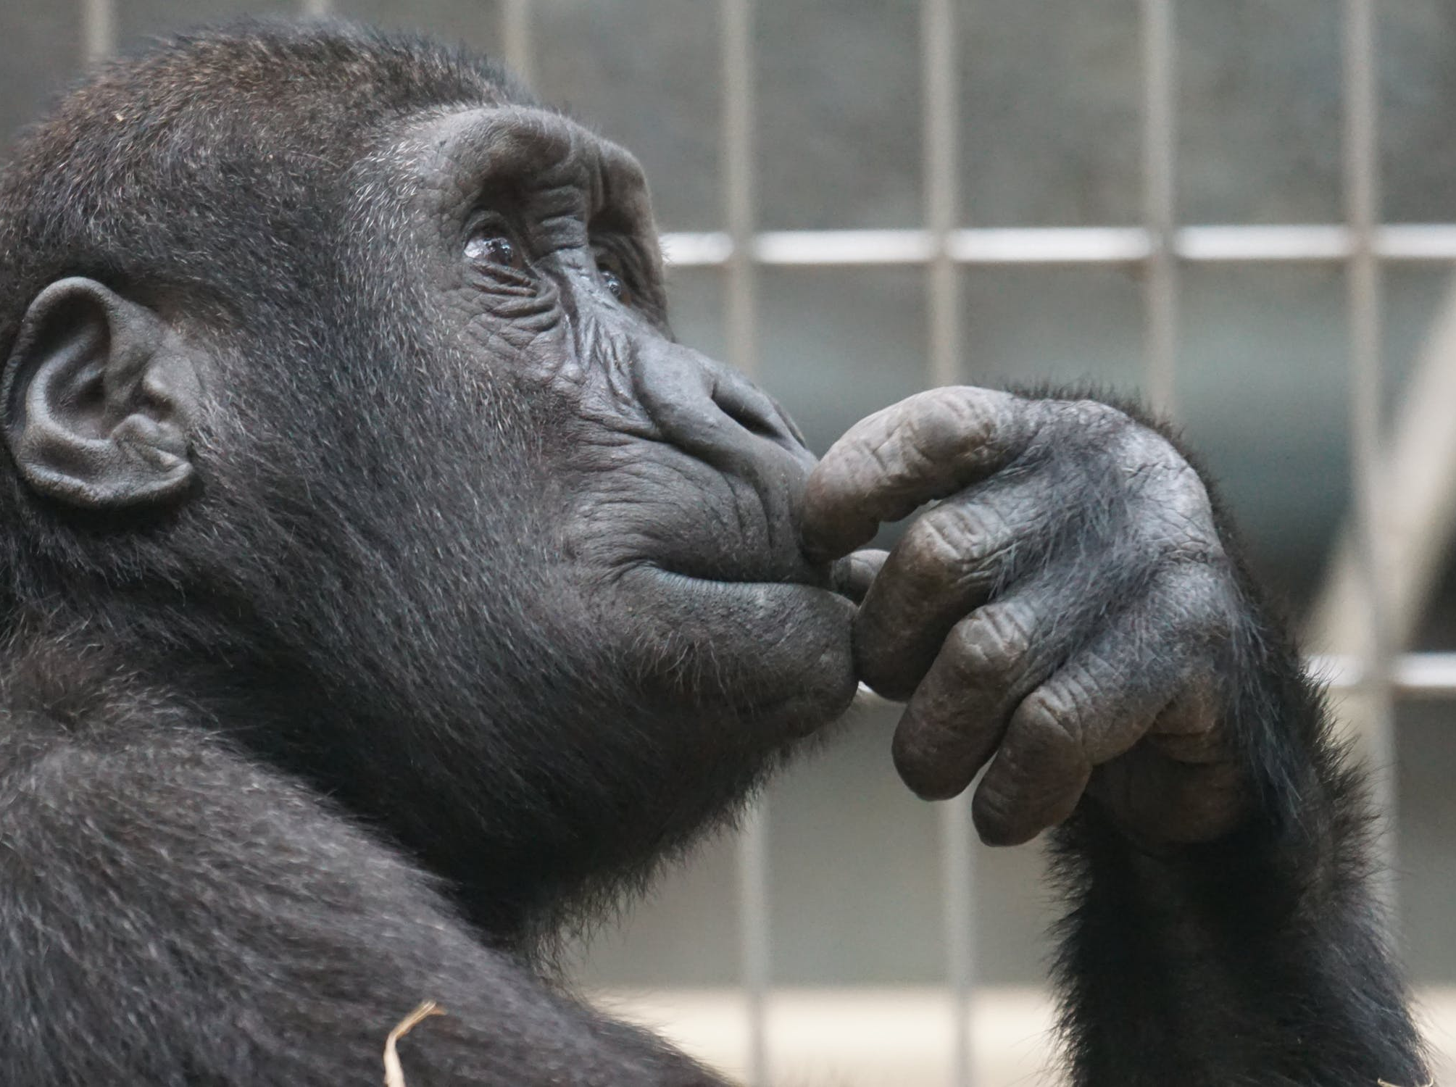
YOU’RE PROBABLY THINKING
WHAT SHOULD
I DO NEXT?
Notes:
Every self-conscious being is continuously confronted with the question: “What should I do next?”
Fast Thinking serves up answers to this question every time it is asked, based on the associations it has been programmed with.
If you program Fast Thinking with things you don’t want, it will inspire you to take actions that create the things you don’t want.
If you program Fast Thinking with things you do want, it will inspire you to take actions that create the things you do want. This may look like “magic”, but it is simply preparation meeting opportunity. … and speaking of preparation …

Slide 47

“
YOUR FAST THINKING RUNS A MASSIVE
REALITY SIMULATOR
Notes:
Your Fast Thinking runs a massively parallel reality simulator.
Unlike our Slow Thinking which is linear, your Fast Thinking can search through literally millions of simulated realities at the same time.
Your Fast Thinking has the ability to find patterns that Slow Thinking can not.
For example, Fast Thinking can run millions of possible simulations of social situations to find the one solution it is looking for. It then serves up that one solution to your consciousness as an impulse to say or do something specific.

Slide 48


IT GIVES YOU INSIGHT AND
INSPIRATION
Notes:
Your Fast Thinking has the ability to find patterns that Slow Thinking can not.
For example, Fast Thinking can run millions of possible simulations of social situations to find the one solution it is looking for. It then serves up that one solution to your consciousness as an impulse to say or do something specific.
Have you ever been looking for your keys? That is a physical process which engages your Fast Thinking’s SEARCH functions. Fast thinking not only scans your environment, but it also begins to search your memories and replays events from today. When it finds your keys, you have a sudden “ah ha!” experience, sometimes so strong you can actually feel it in your body. This is the chemical feeling of inspiration – a specific neurotransmitter that is released in your body when Fast Thinking finds what it is looking for. The more “important” the match, the bigger the feeling.

Slide 49

FAST THINKING ISN’T A JUDGE
IT DOESN’T
KNOW WHAT
SUCCESS IS
YOU MUST TELL IT. RE-PROGRAM IT.
Notes:
Remember Fast Thinking does not make value judgments.
Other than the most basic survival drives, Fast Thinking relies upon Slow Thinking to set priorities and select goals.
It is up to you to instruct your Fast Thinking what patterns to search for, by programming it through
visualization and affirmation,
backed up by your beliefs, emotions, and actions.
(Huh, sounds like the IP Workbook!)

Slide 50

SPECIFY WHAT
PATTERNS YOU’RE
LOOKING FOR
Notes:
Remember Fast Thinking does not make value judgments.
Other than the most basic survival drives, Fast Thinking relies upon Slow Thinking to set priorities and select goals.
It is up to you to instruct your Fast Thinking what patterns to search for, by programming it through
visualization and affirmation,
backed up by your beliefs, emotions, and actions.
(Huh, sounds like the IP Workbook!)

Slide 51

WE FOUND THE MANUAL
Notes:
Triggers in the form of sensory stimulation are raining down on you continuously.
Our nervous system captures a staggering amount of data and almost all of it is screened out before it reaches our consciousness.
BUT!...

Slide 52
THE SOURCE OF CREATION
CREATIVITY
5

Slide 53

CREATIVITY IS AT THE CORE
“
OF OUR ABILITY TO CREATE
Notes:
It should be no surprise that “creativity” is at the core of our power to create the life we intend.

Slide 54



LET’S DEFINE CREATIVITY
PRACTICAL
PSYCHOLOGICAL
Assemble resources in new ways
Quickly generate many
different ideas
Notes:
In practical terms, creativity is:
The ability to assemble resources in new ways to more effectively bring about the situation we wish.
In psychological terms, creativity is:
The ability to quickly generate many different ideas that lead towards our intention.

Slide 55


CREATIVITY IS AN INVESTMENT
Notes:
Like any investment, you have to have resources to set aside.
Because most of the ideas produced during a creative process are never pursued further, creativity is inherently expensive. For this reason, the more abundant our resources the more easily we will find creative ex

Slide 56
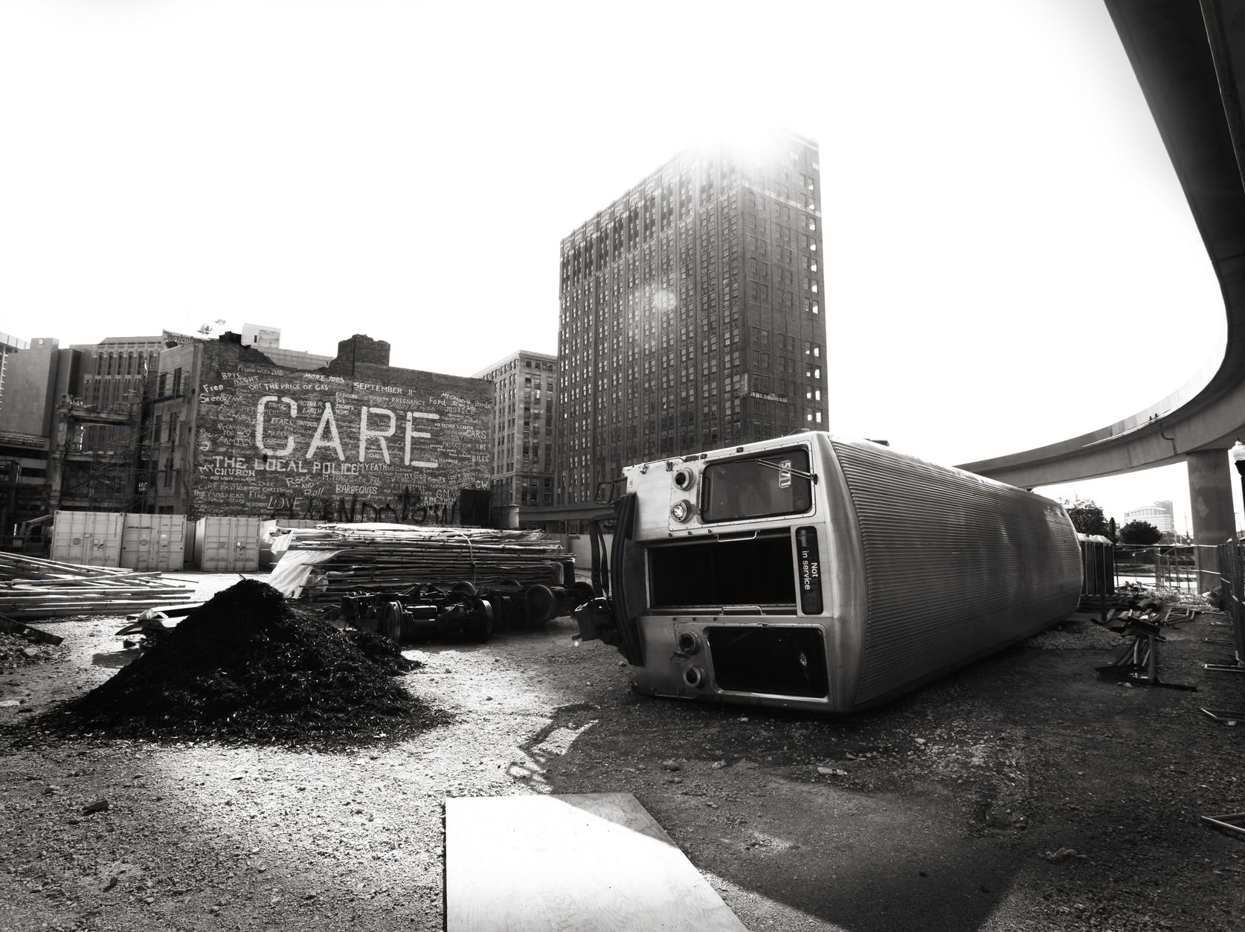
WHAT
DERAILS
CREATIVITY?

Slide 57

DISTRACTION

Slide 58

FATIGUE

Slide 59

DEPRIVATION

Slide 60

THREAT

Slide 62

?
WHAT IS YOUR
THREAT LEVEL
MAXIMIZE YOUR CREATIVITY
Notes:
Note that the emotional states with the lowest possible threat levels – and therefore the places from which you can be maximally creative – have names like “gratitude” and “love”.

Slide 63
RECLAIM
YOUR POWER
6
KICK UNHEALTHY HABITS

Slide 64

WILLPOWER CAN’T RESIST YOUR HABITS
“
BUT IT CAN ERASE THEM
Notes:
Because your normal consciousness is not really involved once a habit has been learned, it is nearly impossible for your willpower to directly oppose a habit. All that happens is you fail, and begin to associate trying to resist the habit with failing to resist the habit – and become even more deeply captured by the habitual behavior. Direct opposition as we’ve learned throughout this class is almost always a bad way to use our energy. Instead we need to remove the habit’s source of energy – and move it from the brain’s automatic habit superhighway back into the realm of something we make conscious choices about.

Slide 65

EVERY HABIT STARTED THE SAME WAY
WITH ASSOCIATIONS
Notes:
Even the most powerful habits and addictions began as associations, and a simple process can break them.

Slide 66

“
YOUR TWO BEST FRIENDS:
PROCRASTINATION
& DISTRACTION
Notes:
Procrastination & Distraction
Procrastination:
When you feel the urge to act arise: delay!
The classic: “Count to 10.”
Others:
“I will check again for his text messages after 6 slow breaths.”
“I will eat the donut after I walk around the block first.”
Create delays of at least two minutes if at all possible.
Distraction:
During that delay: Change your focus!
Socialize, eat or drink
Wash your hands
Take a walk
Play a game
Watch a video
Engage your senses
Instead of acting out the habitual behavior, give your Fast Thinking new associations! This is not a trick to deny yourself. After the delay, you can always perform the habit if you still want to. Just by waiting, it will be weaker.

Slide 67


Daniel Kahneman, Thinking, Fast and Slow.
Jonah Lehrer, How We Decide.
Richard Precht, Who Am I, and If So, How Many?
Steven Pinker, How the Mind Works.
Malcolm Gladwell, Blink.
John Medina, Brain Rules.
Rich Hanson, Buddha’s Brain.
Thomas Metzinger, The Ego Tunnel.
Presenter: david@casti.com

