Slide 1
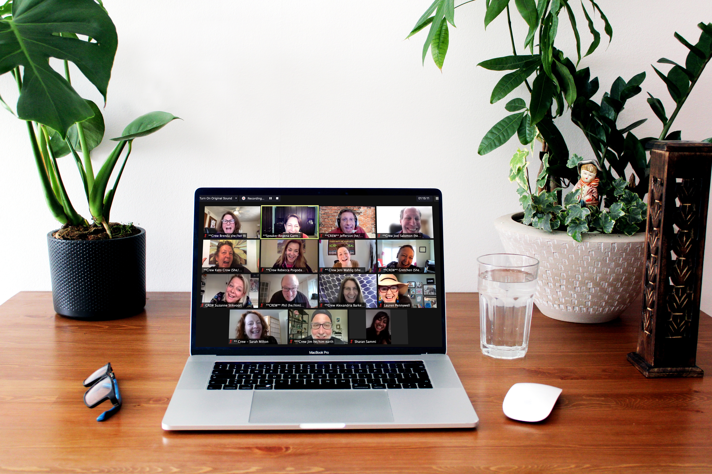

Fall 2021

Slide 2



Slide 3








2021 Virtual
Certification Conference
Notes:
This template can be used as a starter file to give updates for project milestones.
Sections
Right-click on a slide to add sections. Sections can help to organize your slides or facilitate collaboration between multiple authors.
Notes
Use the Notes section for delivery notes or to provide additional details for the audience. View these notes in Presentation View during your presentation.
Keep in mind the font size (important for accessibility, visibility, videotaping, and online production)
Coordinated colors
Pay particular attention to the graphs, charts, and text boxes.
Consider that attendees will print in black and white or grayscale. Run a test print to make sure your colors work when printed in pure black and white and grayscale.
Graphics, tables, and graphs
Keep it simple: If possible, use consistent, non-distracting styles and colors.
Label all graphs and tables.

Slide 4


Slide 5


Certification Conference
Notes:
This template can be used as a starter file to give updates for project milestones.
Sections
Right-click on a slide to add sections. Sections can help to organize your slides or facilitate collaboration between multiple authors.
Notes
Use the Notes section for delivery notes or to provide additional details for the audience. View these notes in Presentation View during your presentation.
Keep in mind the font size (important for accessibility, visibility, videotaping, and online production)
Coordinated colors
Pay particular attention to the graphs, charts, and text boxes.
Consider that attendees will print in black and white or grayscale. Run a test print to make sure your colors work when printed in pure black and white and grayscale.
Graphics, tables, and graphs
Keep it simple: If possible, use consistent, non-distracting styles and colors.
Label all graphs and tables.

Slide 6
A Note from the Universe...
To find out how much you've truly been blessed with -- in terms of love, time, energy, talent, joy, abundance, confidence, intelligence, wit, or any other quality, substance, or dispensation --
Then you'll know what
boundless really means.
Tallyho,
The Universe
give of them.

Slide 7
Conference Overview
I will share:
  My Story - A Profitable Case Study
  IP Today - News & Resources
  IP Workshop & Workbook Review
  Philosophy & Concerns
  Questions & Answers
The Speakers will share:
  Their Story, Content & Style
No pressure
I will speak as if you are Trainers
My PowerPoints on Conference Resource Page
Evaluation Survey to be sent in an email link
Notes:
What is the project about?
Define the goal of this project
Is it similar to projects in the past or is it a new effort?
Define the scope of this project
Is it an independent project or is it related to other projects?
* Note that this slide is not necessary for weekly status meetings

Slide 8
A Case Study
of Profitable
Selfish $ervice
11:06 AM
Notes:
The following slides show several examples of timelines using SmartArt graphics.
Include a timeline for the project, clearly marking milestones, important dates, and highlight where the project is now.

Slide 9
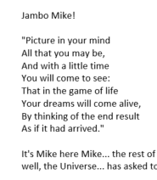



Monday Morning Motivators
M. Dooley, C.P.A.
eZINE
Resume
http://www.tut.com

Slide 10

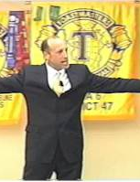
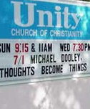
Rotary Clubs
Toastmasters
Unity Churches, Circa 2001

Slide 11

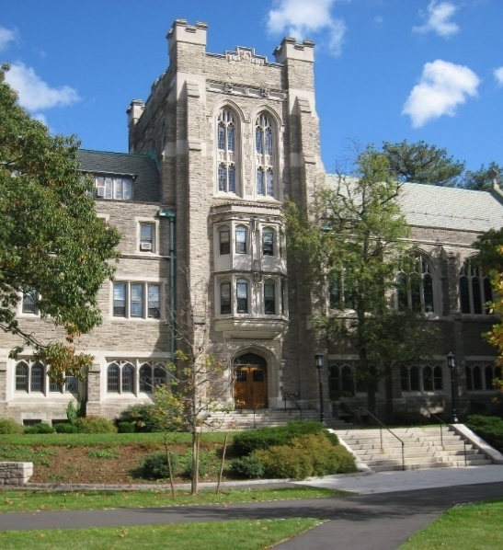


Infinite Possibilities
Networked
Dream Biz Model

Slide 12

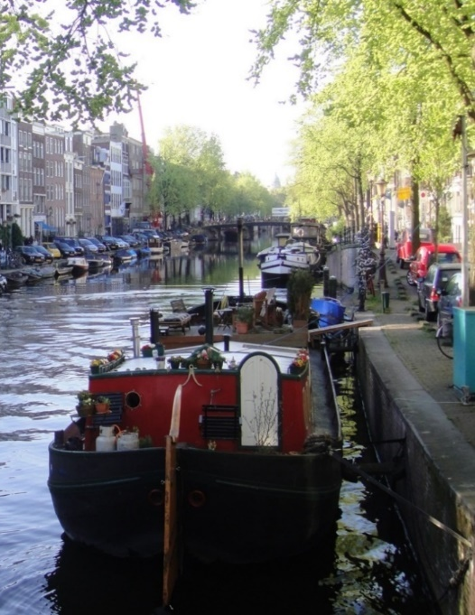

LONDON
HOLLAND
World Tour 1

Slide 13
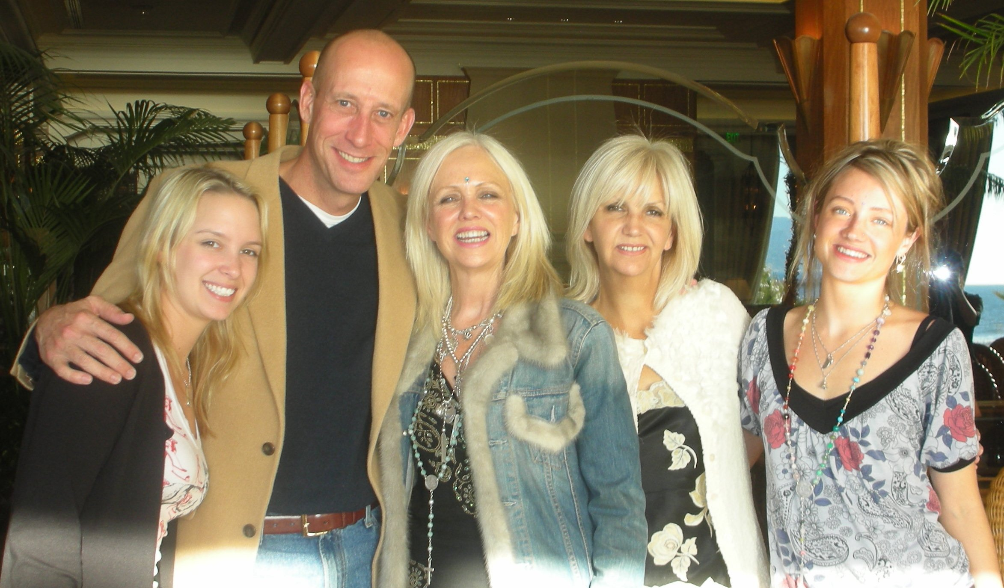


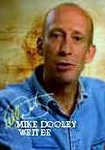

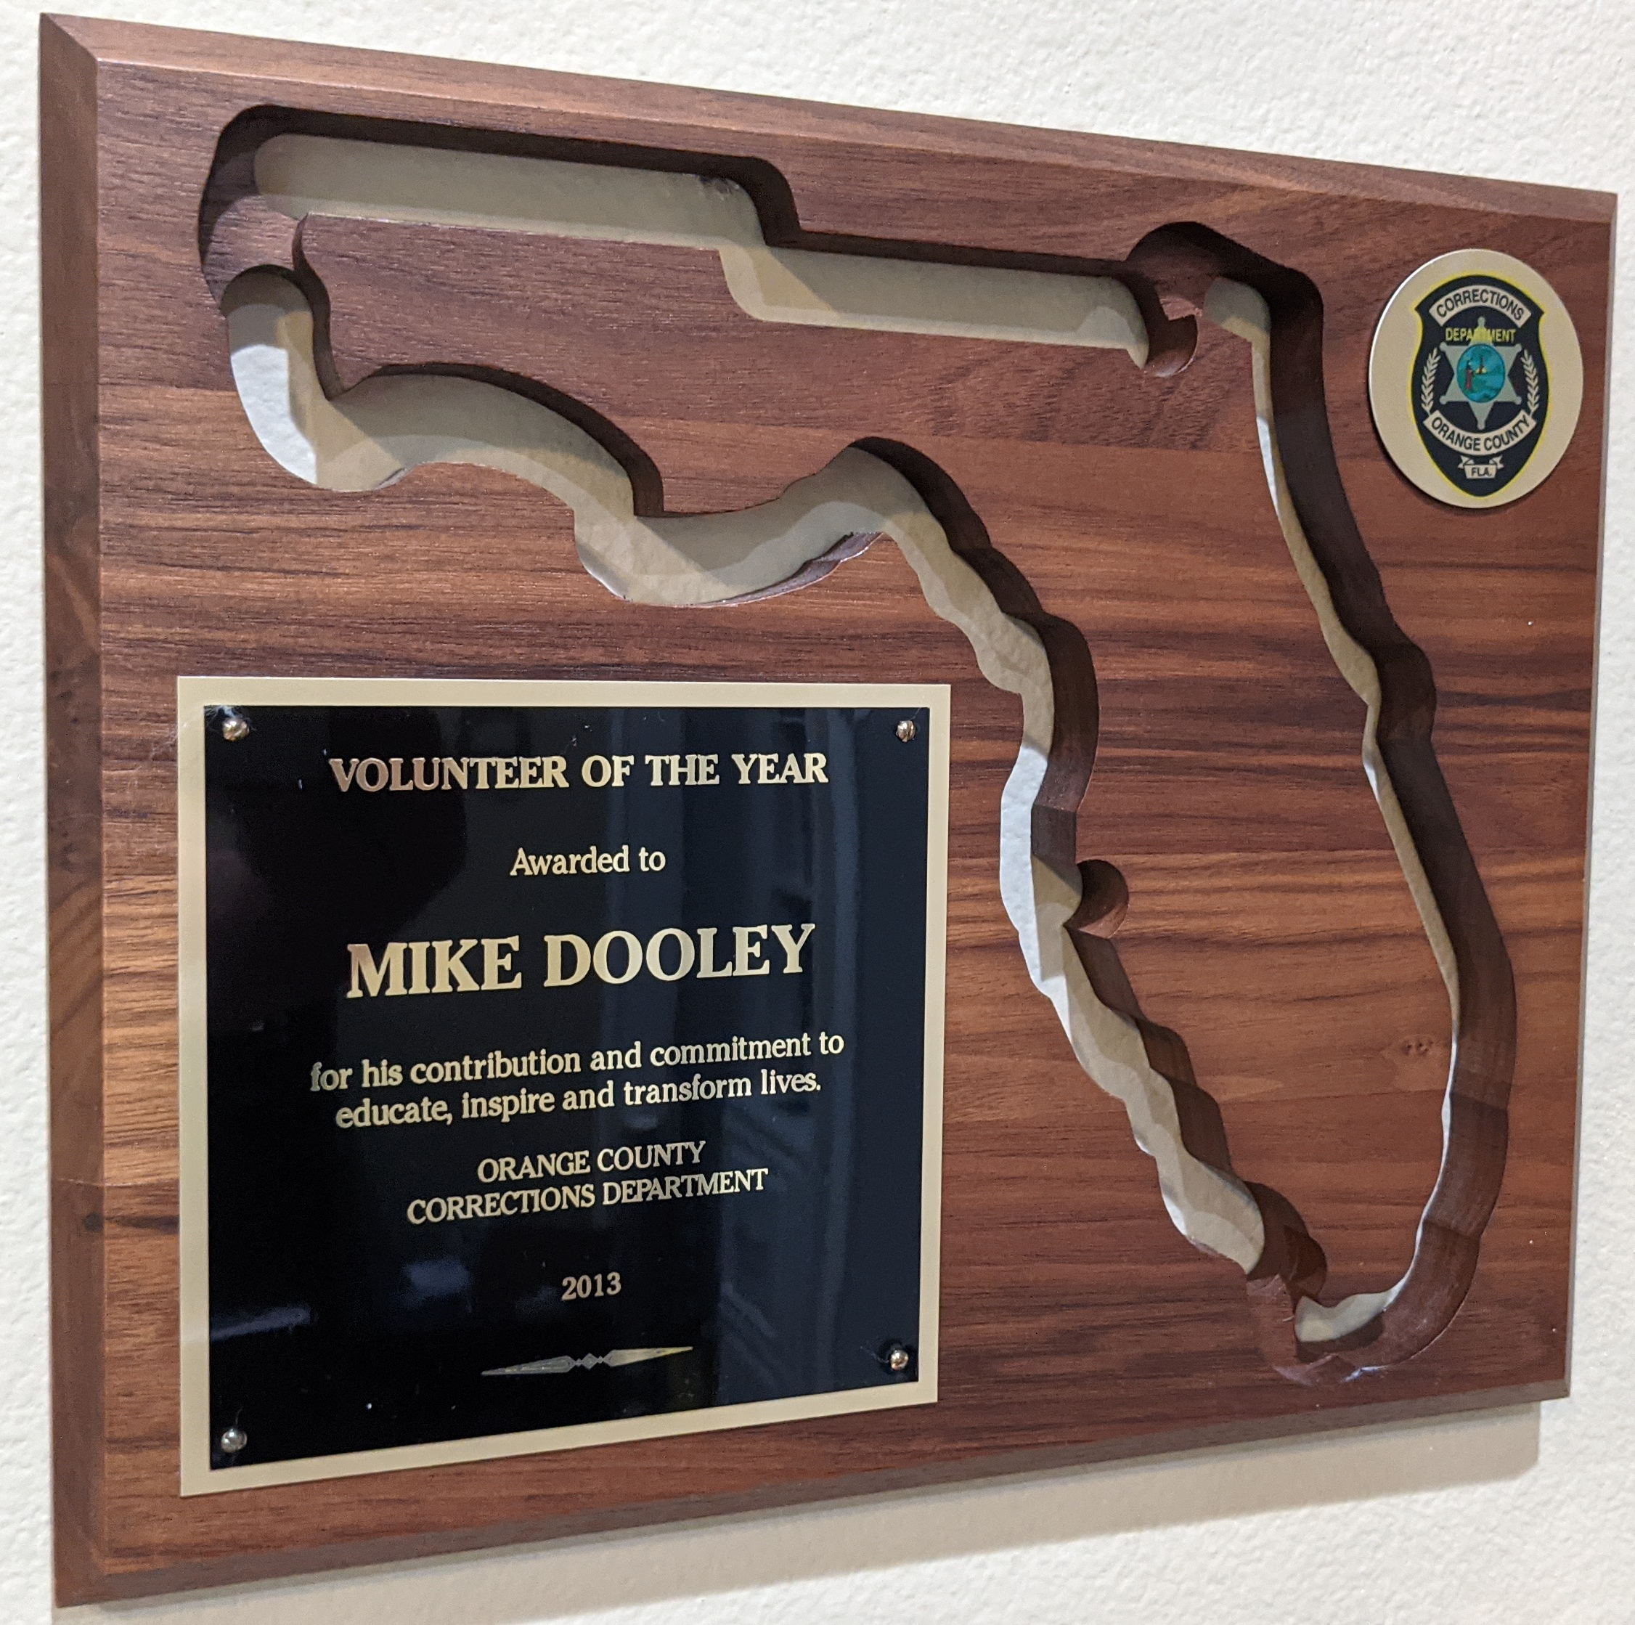


The Secret
#7
The Book Edition!
Orange County, Fl
Corrections Department
(The Orlando Jail)
The Secret!

Slide 14

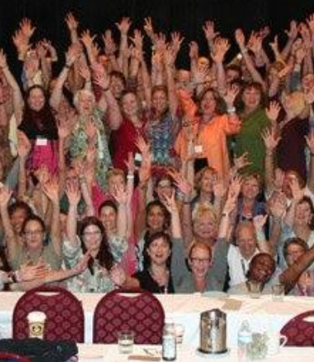

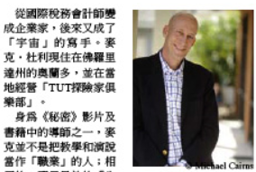
42 Countries
IP Train the Trainer
Infinite Possibilities
now in 15 Languages

Slide 15
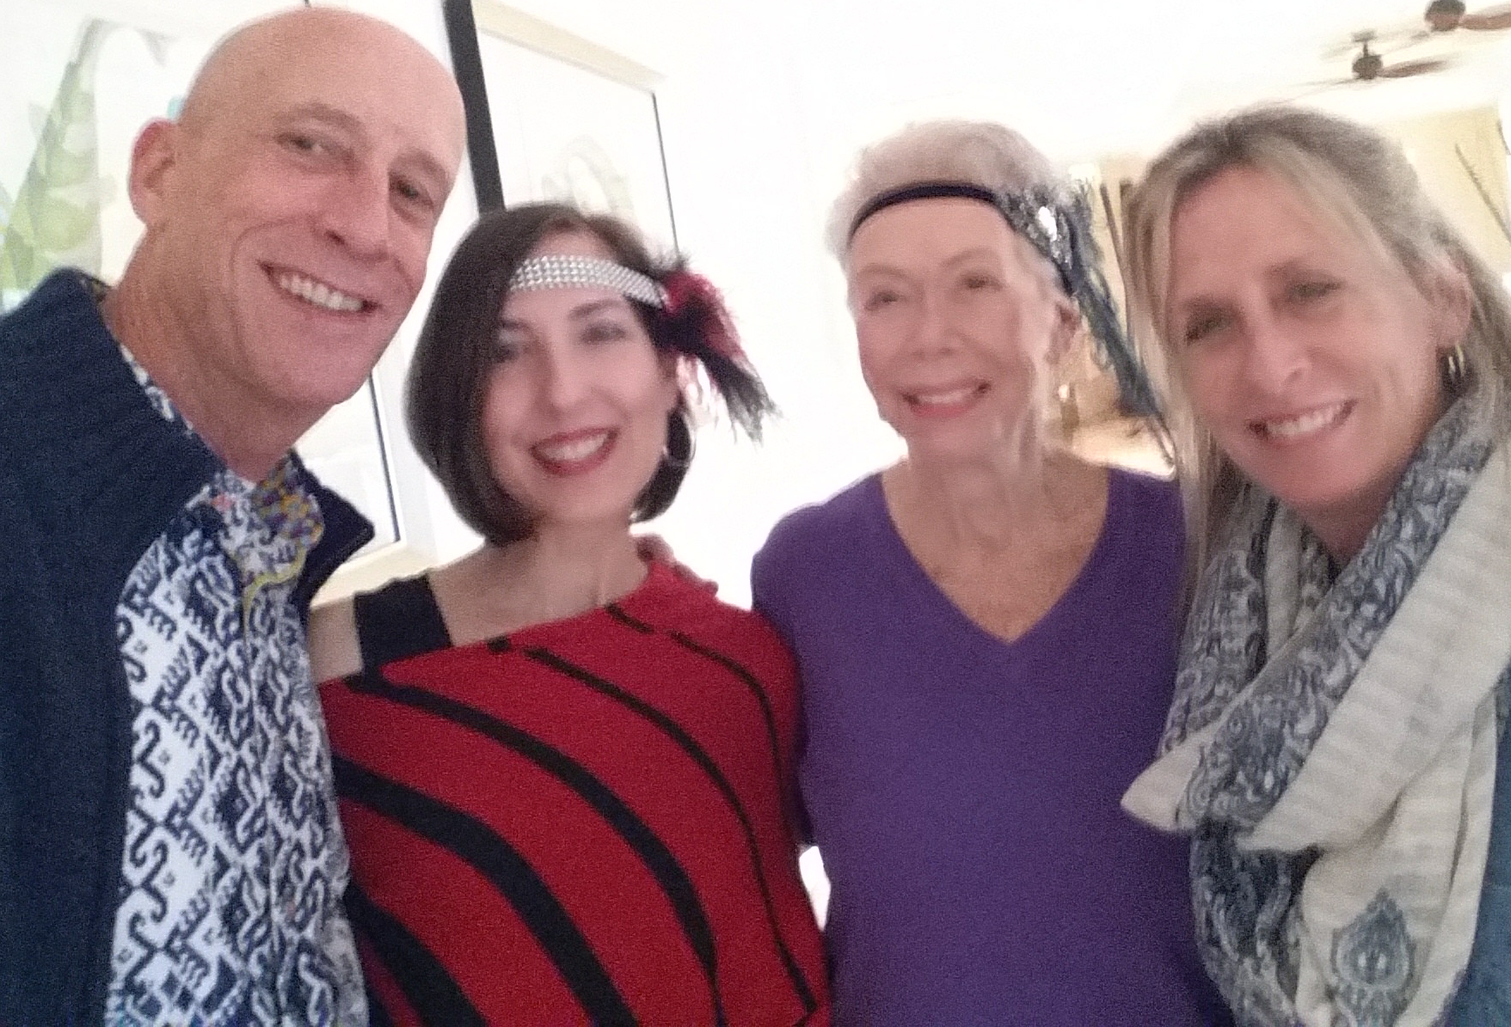
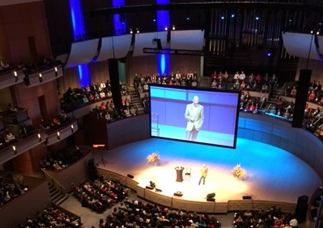
HAY HOUSE * I CAN DO IT!
Louis Hay

Slide 16
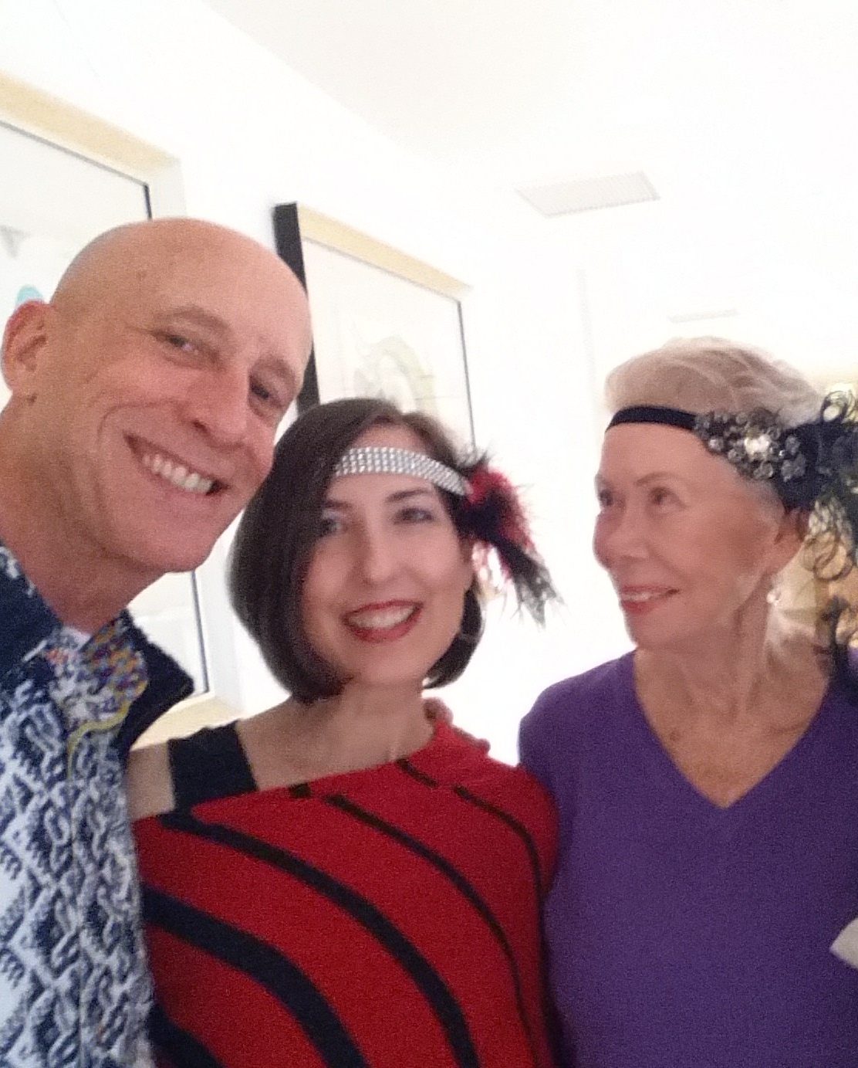
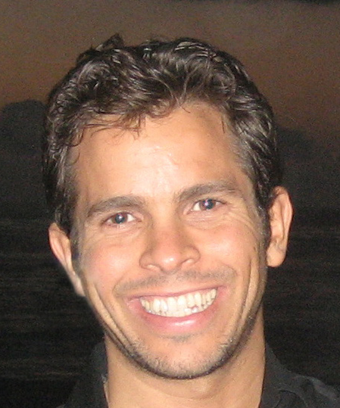
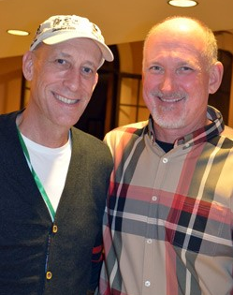
Louise Hay
Nick Ortner
Reid Tracy

Slide 17
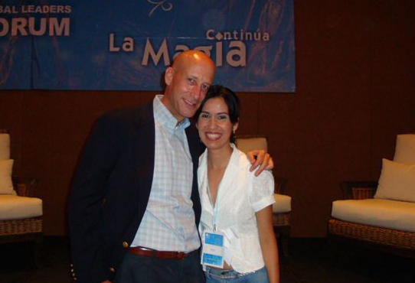
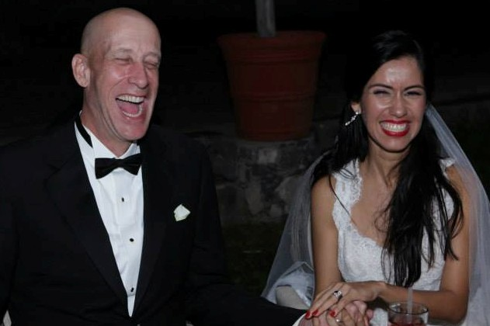
Puerto Vallarta 2008
2013 Wedding

Slide 18
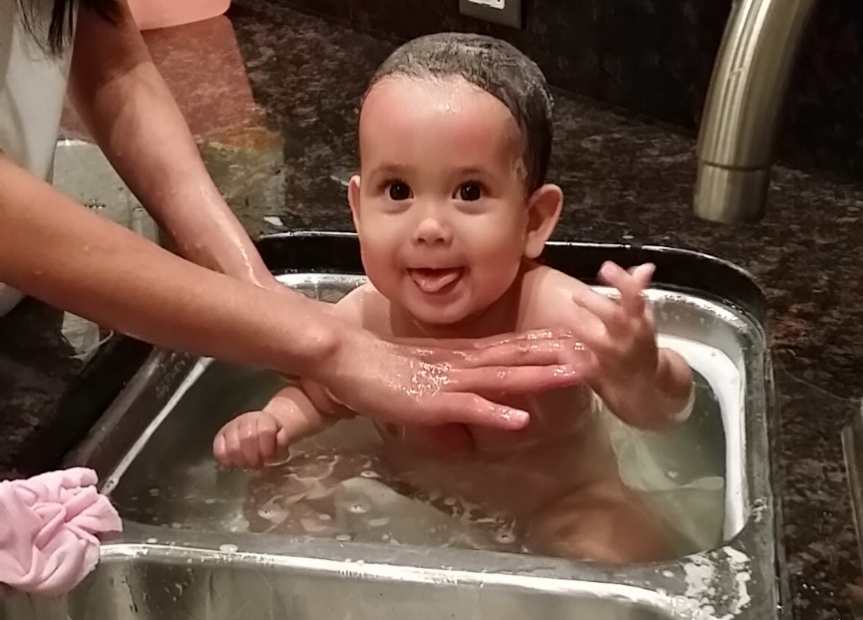

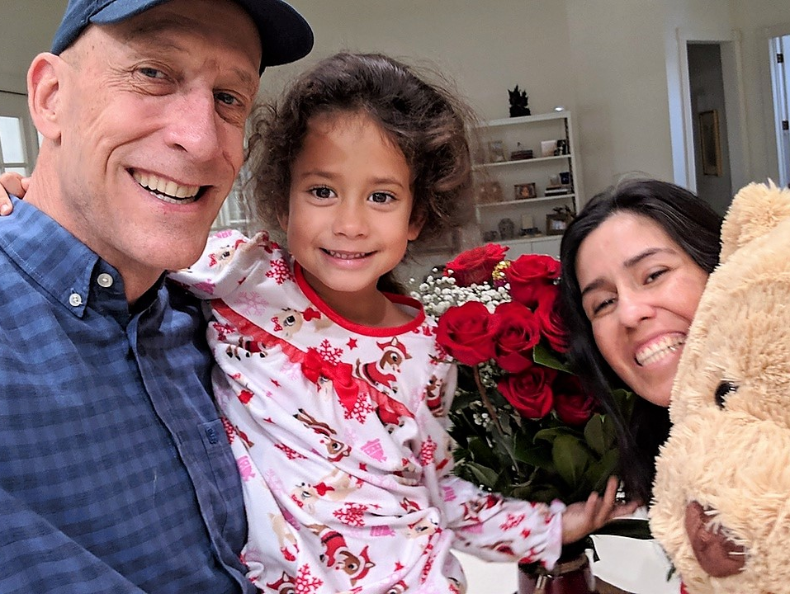
2014
TODAY

Slide 19

Thoughts
Become
Things!
11:06 AM
Notes:
When I prayed on my knees with my 4 end results, the Universe said, “I know how.”

Slide 20
Lessons from the field…
You don’t have to know how you got where you are,
to learn how to move from it.
Take unending baby steps down your least sucky paths.
Don’t go down just one path at a time.
Don’t wait until you’re ready.
You teach best what you most need to learn.
Seeming failures are part of the miracles; refrain from passing judgment on your journey with your physical senses.
Sometimes knocking on one door causes a better one to open.
When dreams come true they always exceed your
earlier wildest expectations.
Secret Code: DREAM
11:06 AM
Notes:
The following slides show several examples of timelines using SmartArt graphics.
Include a timeline for the project, clearly marking milestones, important dates, and highlight where the project is now.

Slide 21
IP TODAY
STATS, TOOLS AND RESOURCES

Slide 22
This is the 17th Conference since our launch in 2011!
2,353 Certified Trainers (Ippies)
In 44 countries
477 Trailblazers
47 Playing the Matrix Certified

Slide 23

This is the 16th Conference since our launch in 2011!
2,140 Certified Trainers (Ippies)
In 42 countries
446 Trailblazers
45 Playing the Matrix Certified
Notes:
10 countries here (2020 virtual event) US Canada Australia Costa Rica Denmark, Peru Germany Great Britain South Africa Netherlands

Slide 24
This is the 15th Conference since Oct 2011 in 8 yrs!
2,054 Certified Trainers (Ippies)
In 42 countries
441 Trailblazers
44 Playing the Matrix Certified
Notes:
10 countries here (2020 virtual event) US Canada Australia Costa Rica Denmark, Peru Germany Great Britain South Africa Netherlands

Slide 25
Denver is the 14th Conference since Oct 2011 in 7 yrs!
1,919 Certified Trainers (Ippies)
Over 42 countries
419 Trailblazers
39 Matrix Certified
Notes:
What is the project about?
Define the goal of this project
Is it similar to projects in the past or is it a new effort?
Define the scope of this project
Is it an independent project or is it related to other projects?
* Note that this slide is not necessary for weekly status meetings

Slide 26
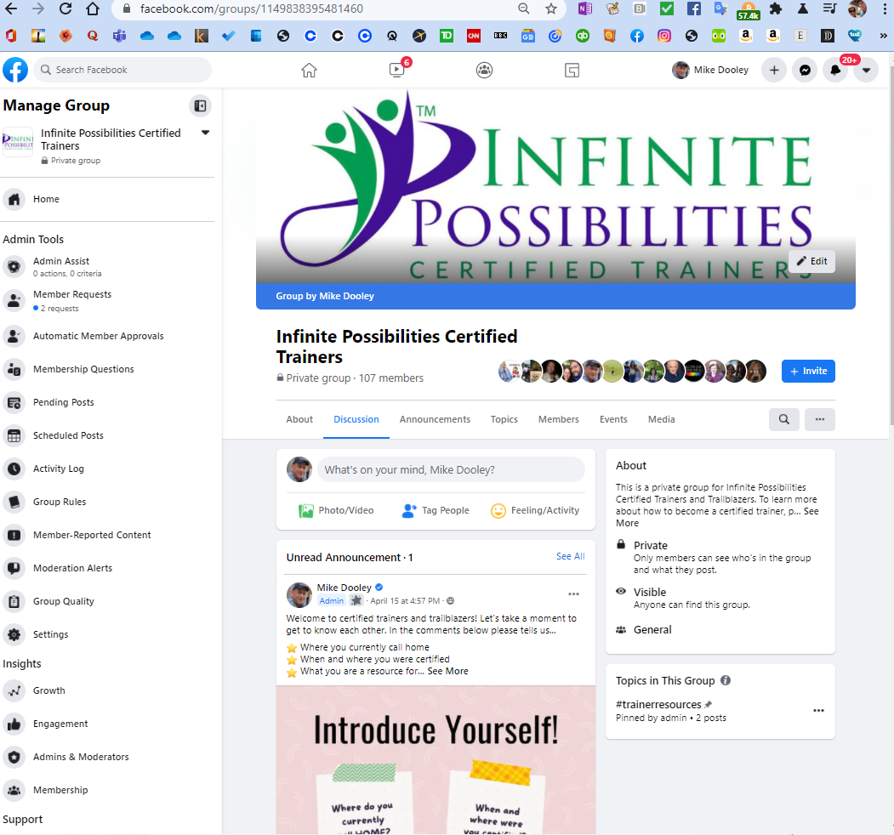
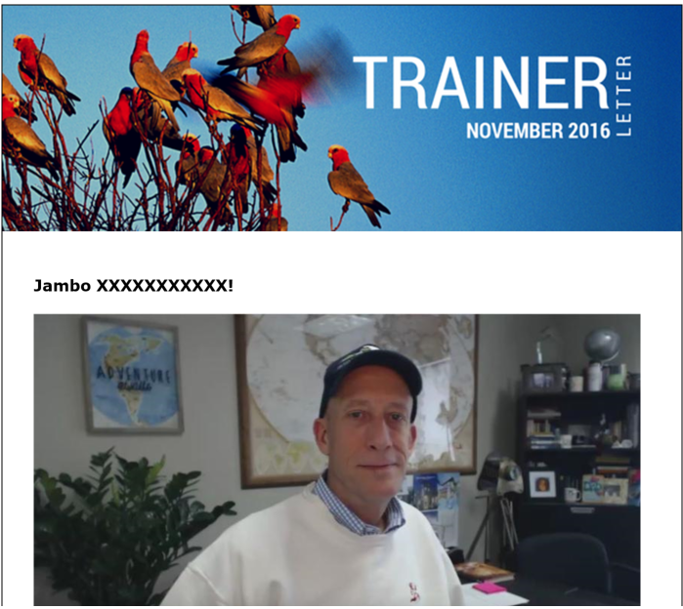
  CONNECTION!
NEWSLETTER
Notes:
What is the project about?
Define the goal of this project
Is it similar to projects in the past or is it a new effort?
Define the scope of this project
Is it an independent project or is it related to other projects?
* Note that this slide is not necessary for weekly status meetings

Slide 27
Workbooks & Trainer’s Guide
in their 6th edition!

Slide 28
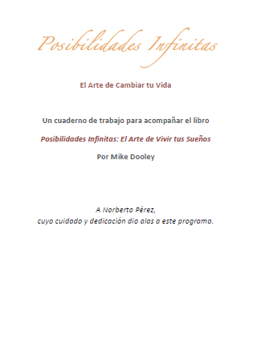

Workbook now in 6 languages: Chinese, Greek, Swedish,
English, Spanish and Dutch
Please contact us if you’d like to enquire about translating a new edition:
trainer@tut.com
Notes:
What is the project about?
Define the goal of this project
Is it similar to projects in the past or is it a new effort?
Define the scope of this project
Is it an independent project or is it related to other projects?
* Note that this slide is not necessary for weekly status meetings

Slide 29


I BELIEVE IN ME! By Rebecca Psigoda
For Kids and Teens!
Notes:
What is the project about?
Define the goal of this project
Is it similar to projects in the past or is it a new effort?
Define the scope of this project
Is it an independent project or is it related to other projects?
* Note that this slide is not necessary for weekly status meetings

Slide 30

Corporate Continuum By Michael Winters
Notes:
What is the project about?
Define the goal of this project
Is it similar to projects in the past or is it a new effort?
Define the scope of this project
Is it an independent project or is it related to other projects?
* Note that this slide is not necessary for weekly status meetings

Slide 31
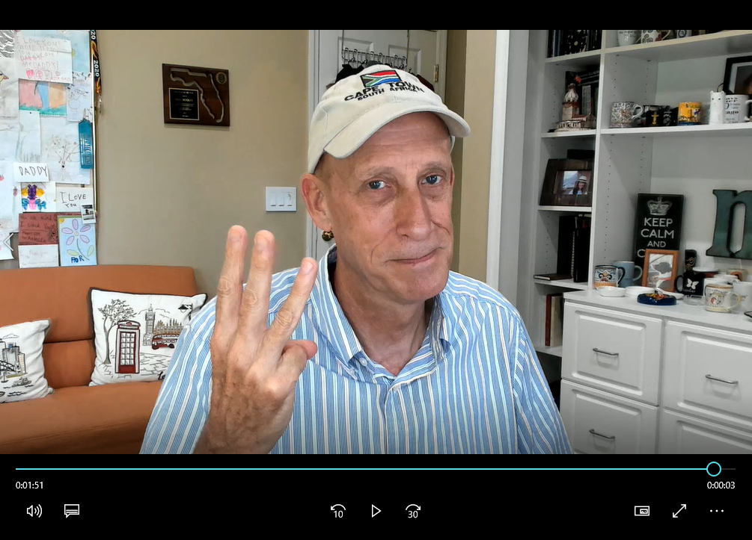
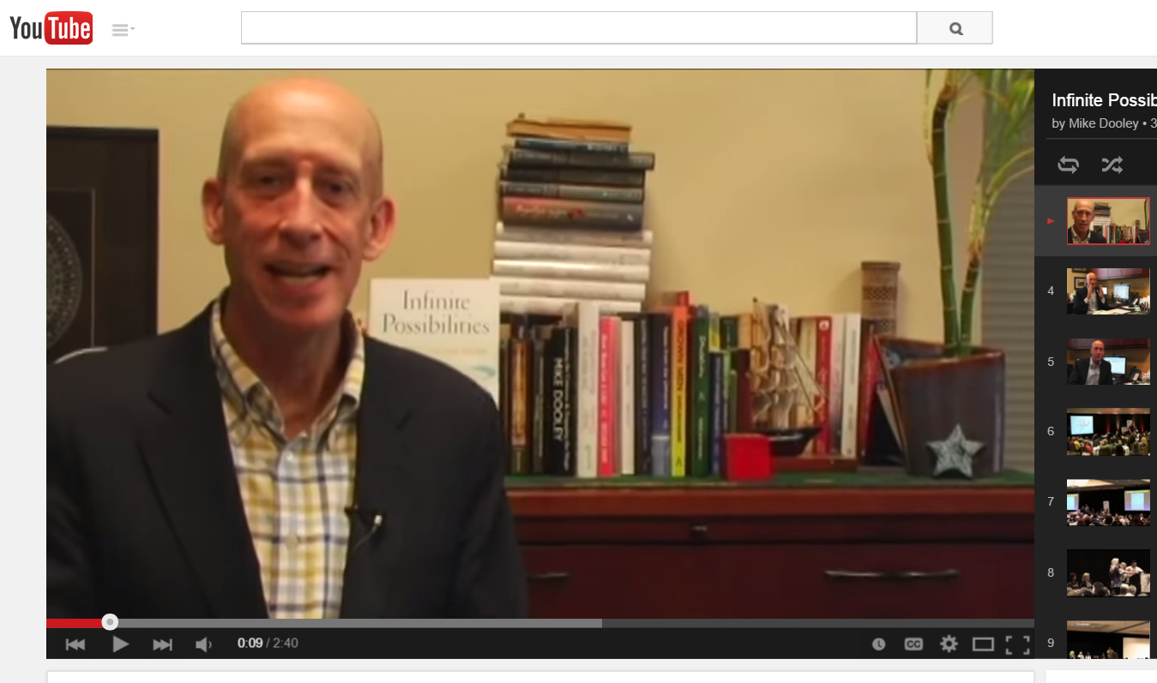
A Program Overview
for your participants!
“Welcome… you are about to learn from someone I have personally trained…”
Notes:
What is the project about?
Define the goal of this project
Is it similar to projects in the past or is it a new effort?
Define the scope of this project
Is it an independent project or is it related to other projects?
* Note that this slide is not necessary for weekly status meetings

Slide 32
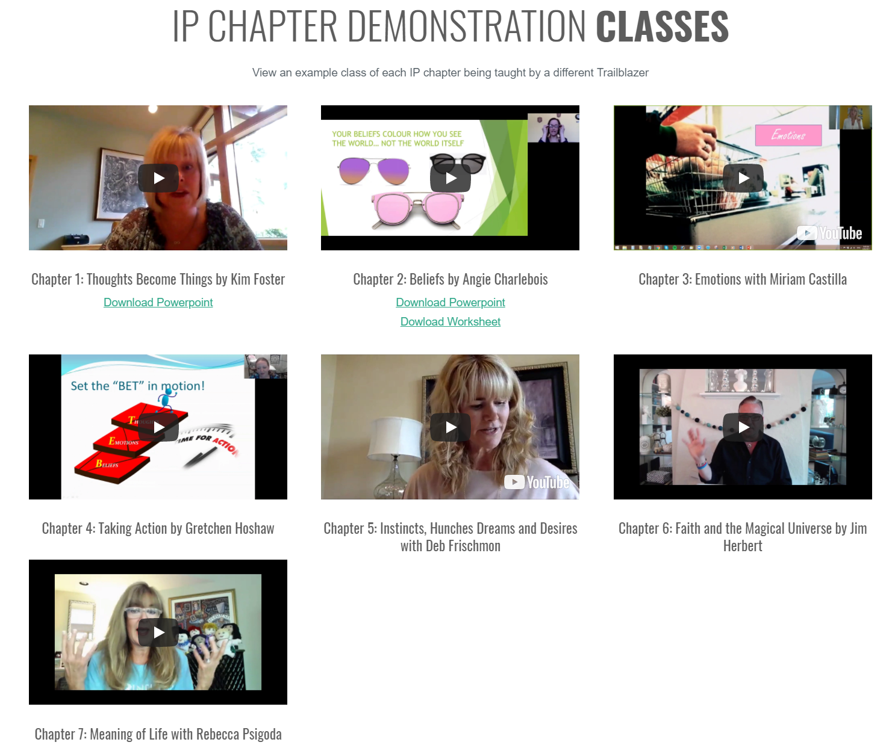

IP CHAPTER
DEMONSTRATION CLASSES
View an example-class of each IP chapter being taught by a different Trailblazer!
Notes:
What is the project about?
Define the goal of this project
Is it similar to projects in the past or is it a new effort?
Define the scope of this project
Is it an independent project or is it related to other projects?
* Note that this slide is not necessary for weekly status meetings

Slide 33
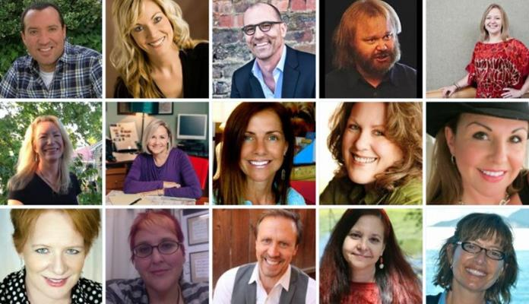
* Continuing Education *
LIVE and archived Zoom Broadcast
Trainings offered by our Trainers!
Notes:
What is the project about?
Define the goal of this project
Is it similar to projects in the past or is it a new effort?
Define the scope of this project
Is it an independent project or is it related to other projects?
* Note that this slide is not necessary for weekly status meetings

Slide 34

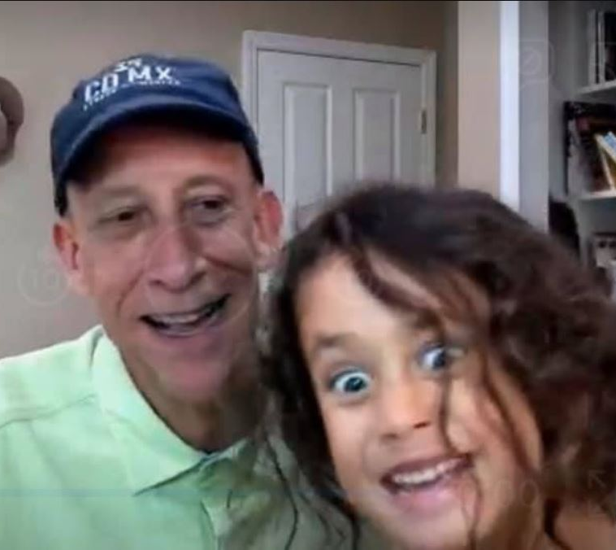
Breaking News!
WE ARE HOME TO THE YOUNGEST CERTIFIED TRAINER
IN THE HISTORY OF
SELF-IMPROVEMENT!!!!
Rebecca
Dooley
Notes:
What is the project about?
Define the goal of this project
Is it similar to projects in the past or is it a new effort?
Define the scope of this project
Is it an independent project or is it related to other projects?
* Note that this slide is not necessary for weekly status meetings

Slide 35
Fall 2021

