Slide 1
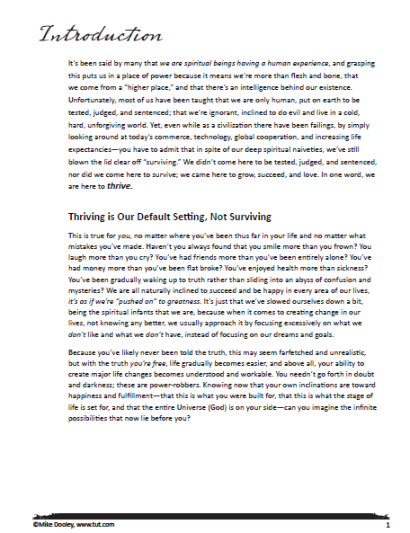



FYI - Page # in workbook
Free-style the first meeting…

Slide 2
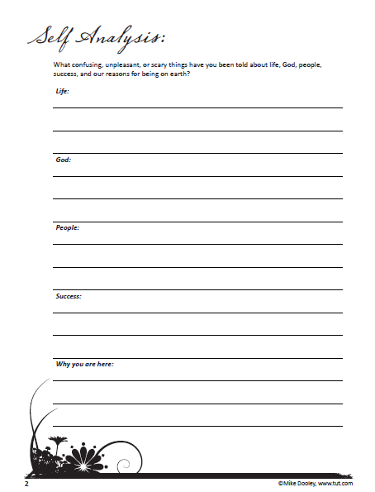




Consider ASKING your audience to shout out answers…
Notes:
Ask for show of hands to interact with audience.
Tell how we might take for granted how many people think like us… very few!

Slide 3
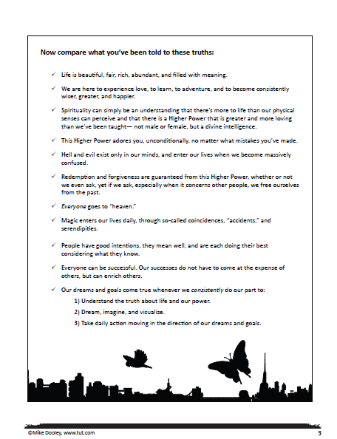

What if….

Slide 4
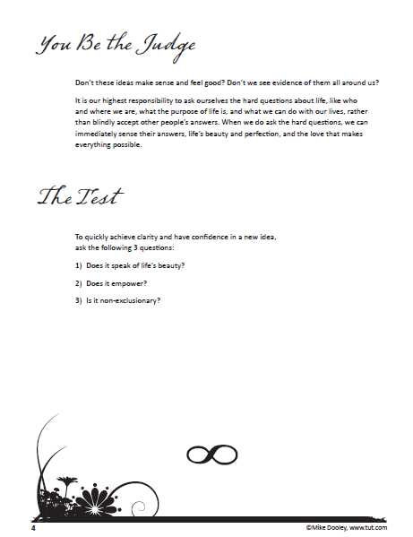





(End of 1st lesson!)

Slide 5

Try telling a personal story…
“I remember my first time…”
“I nearly got fired from my 1st job…”
“Ever hear of athletes visualizing…”
Let’s do this:
Share in a
Breakout Group➔

Slide 6
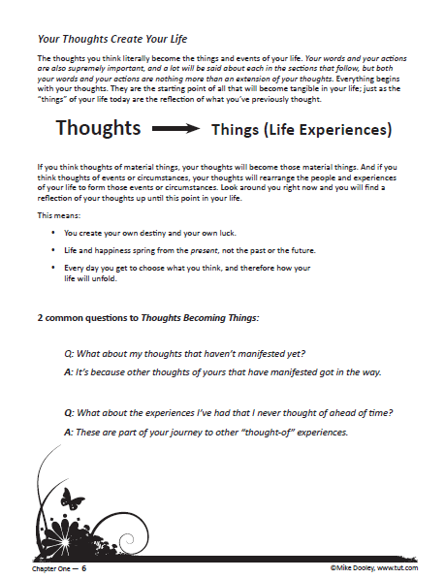



Notes:
THOUGHTS BECOME THINGS!

Slide 7
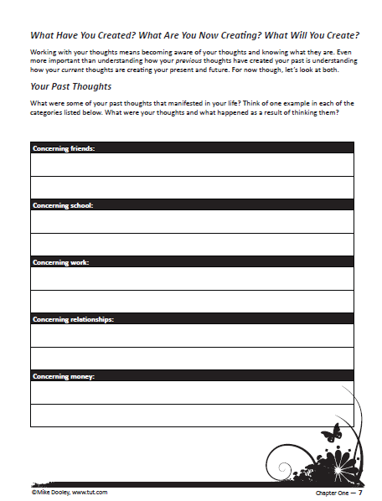



Ask your audience more questions!

Slide 8
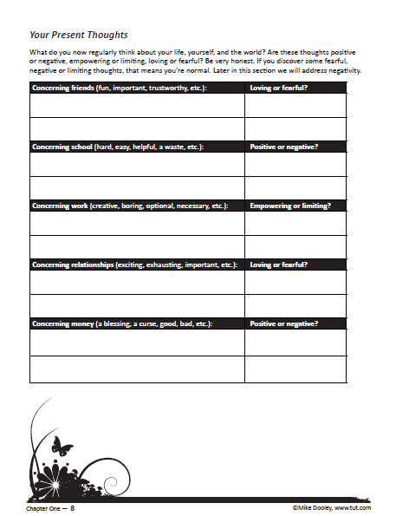

Ask your audience more questions!

Slide 9
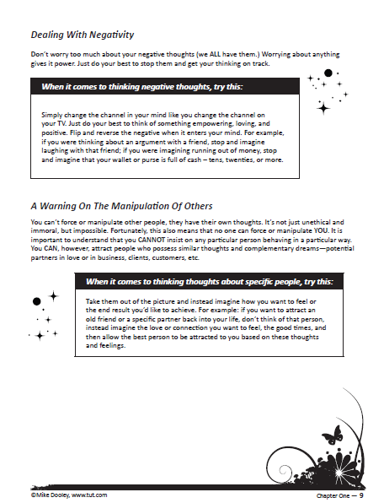




Everyone wants to know…

Slide 10
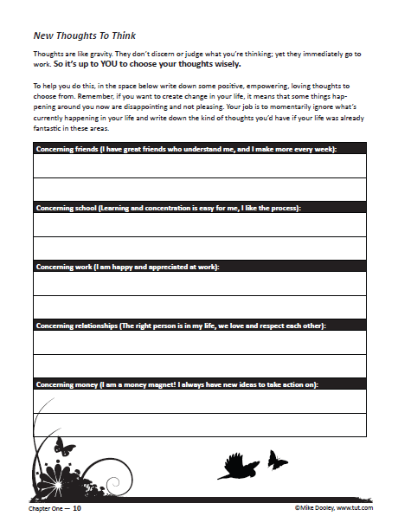


Slide 11

“Infinite Possibilities”
is Evidence Based…
Lean in with something gentle:
“Have you ever heard of athletes using creative visualization?”

Slide 12
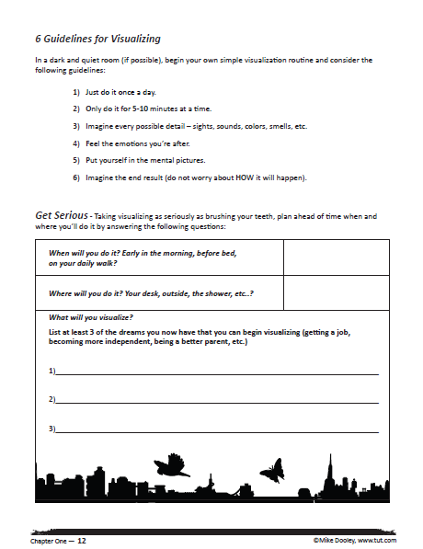





Excite your audience with lists!
Secret Code:
VISUALIZE

Slide 13
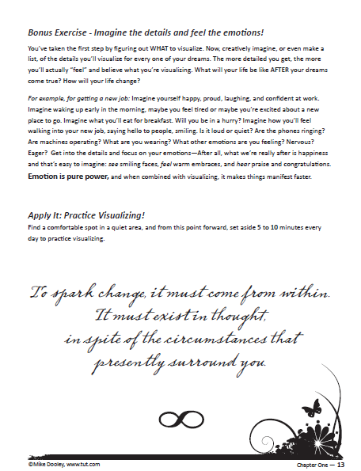

Assign homework…
Practice visualizing everyday.
LET’S DO THIS…
“Close your eyes… imagine it’s sunrise and your sitting on a verandah…”
Notes:
Pre-read slides at end where this is to refresh. Then do it by memory.

Slide 14

Get the
audience involved!?
Muscle Testing Demonstration
California Medical Association
You’re stronger, physically
and mentally when you’re
affirming positive beliefs!
Notes:
Do with volunteer before explaining. HAVE THEM CLAIM… Not worthy… no good… a fake…

Slide 15
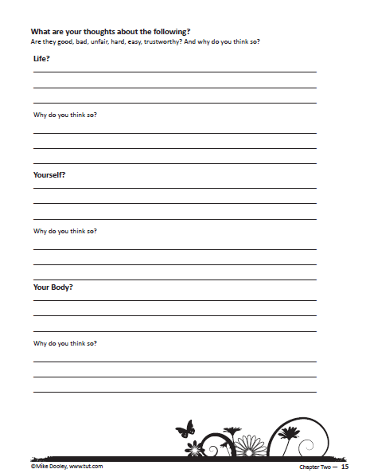




“What are your thoughts about…?”
Tell us in CHAT “the way it is” in each area…

Slide 16
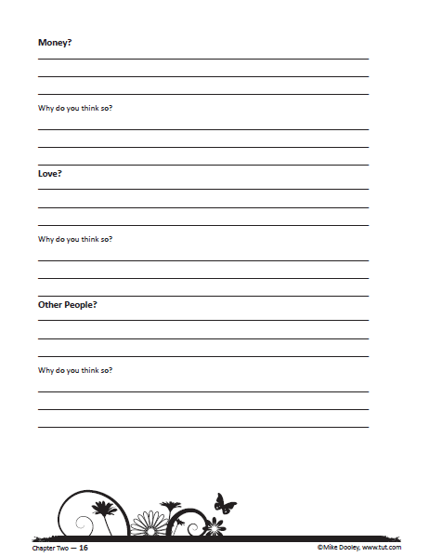
What do you think about…

Slide 17
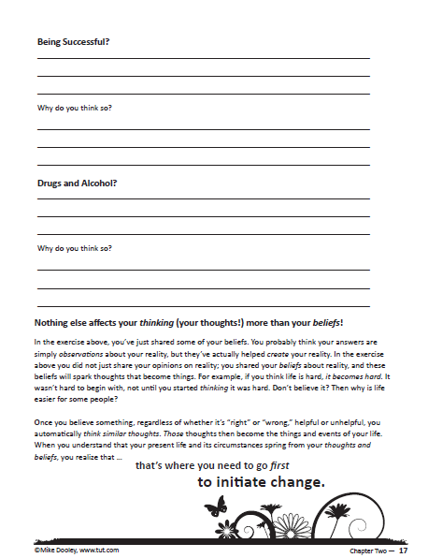
“You’ve just shared with me your BELIEFS!
“Working” these is how to start changing
your life.”

Slide 18


“Are our beliefs more important than our thoughts?”

Slide 19
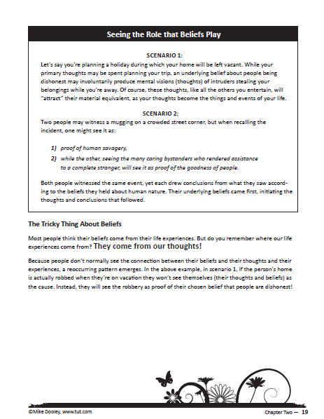

“Most people think their
beliefs are formed by their life experiences…
Actually, it’s the opposite.”

Slide 20
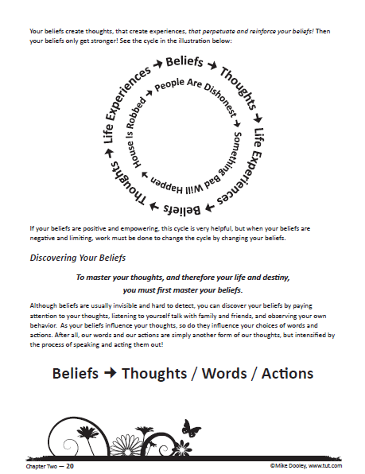






“Our thoughts form our experiences and hence our lives. Listen to yourself to uncover your beliefs.”

Slide 21
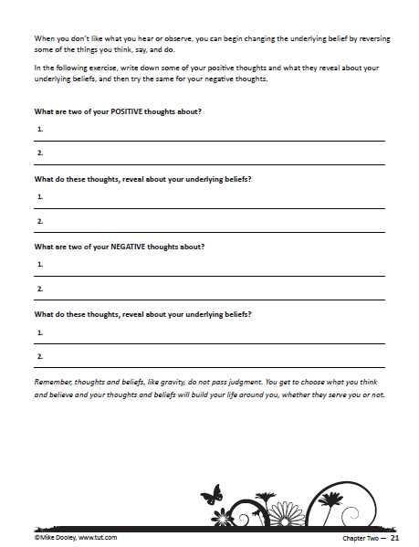


See how your thoughts are borne of your beliefs…

Slide 22
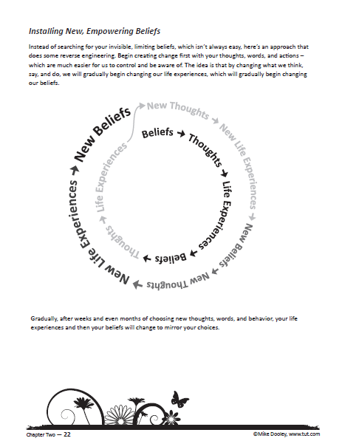

Break a pattern, ANYWHERE.
The easiest place to begin is with new thoughts!

Slide 23
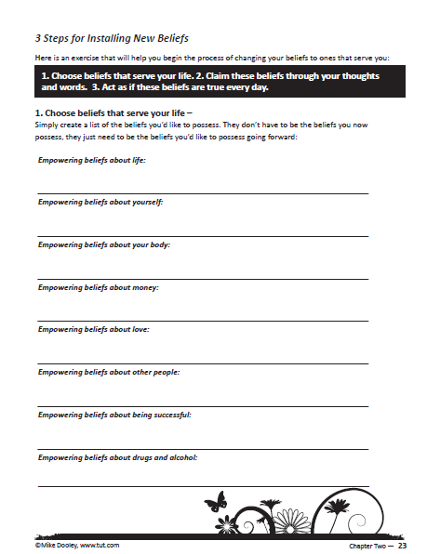


Step: 1
What are some empowering beliefs about MONEY that would serve you?
LET’S DO THIS:
Use a blank sheet
of paper.

Slide 24
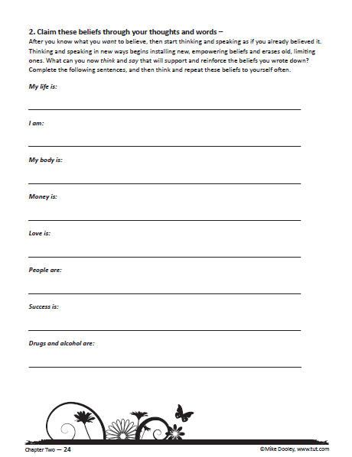










Immersion into Truth
Create affirmations, study them, see their validity!

Slide 25
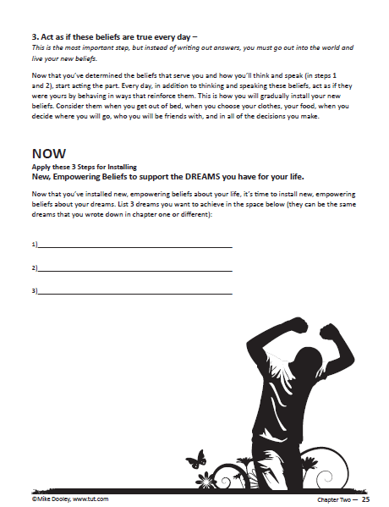

Actions suppress invisible limiting beliefs while installing empowering ones!

Slide 26
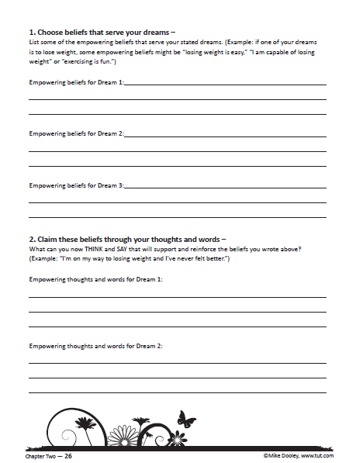


Now ask your audience to apply these
3 Steps to a
SPECIFIC DREAM…

Slide 27
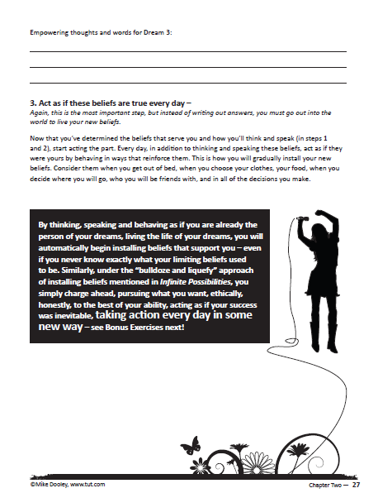


Slide 28
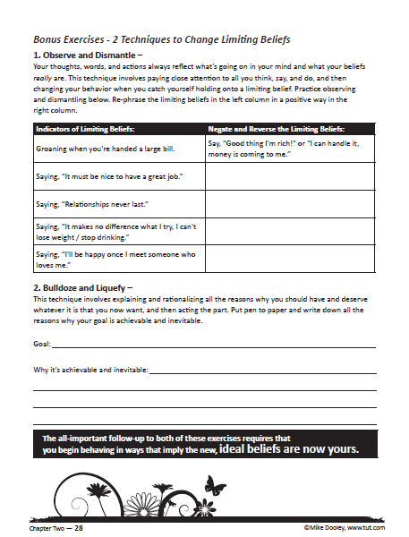


2 More
Bonus Methods for Changing Beliefs!
Notes:
Maybe explain, “reverse worrying.”

Slide 29
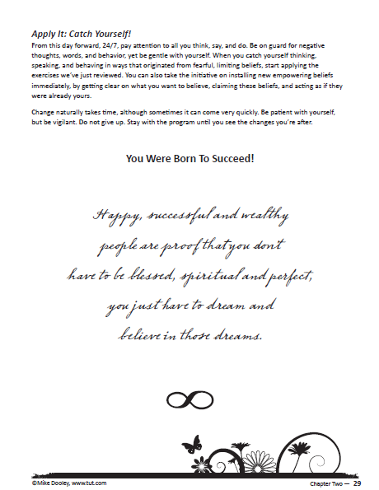




Assign homework…

Slide 30

Emotions
Vs.
Feelings & Intuition
Secret Code:
JOY

Slide 31
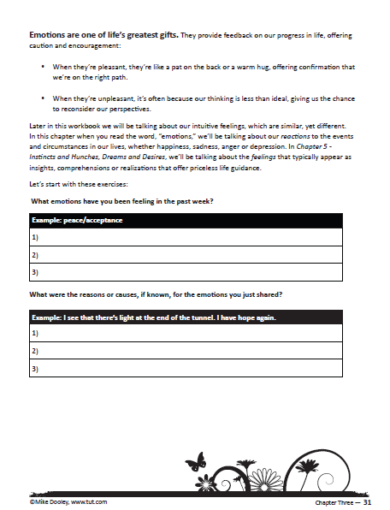



Maybe start this chapter by simply DIVING INTO the exercise…

Slide 32
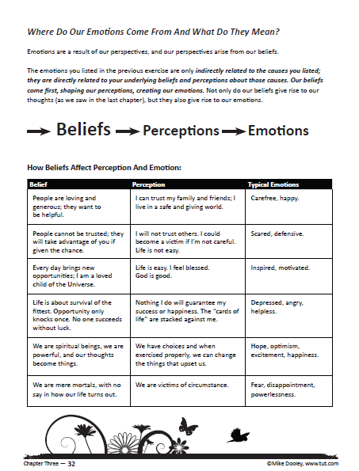




“Where do our emotions come from?
They’re your reaction to events, based upon your beliefs!”
For example:

Slide 33
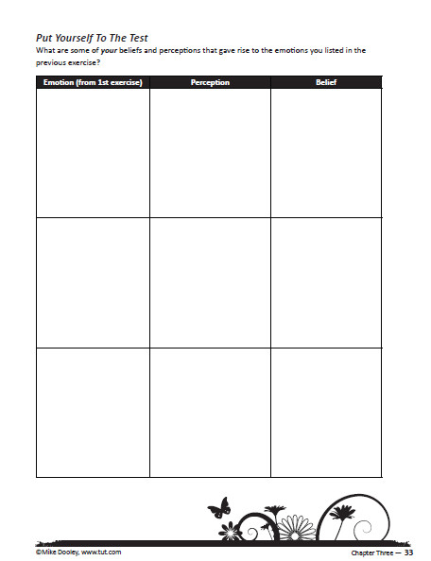

Now work it BACKWARDS –
Working from your FEELINGS to Beliefs
gives you a new starting point. See cycle on next page ➔
Bossy Partner
My options are limited.
Angry

Slide 34
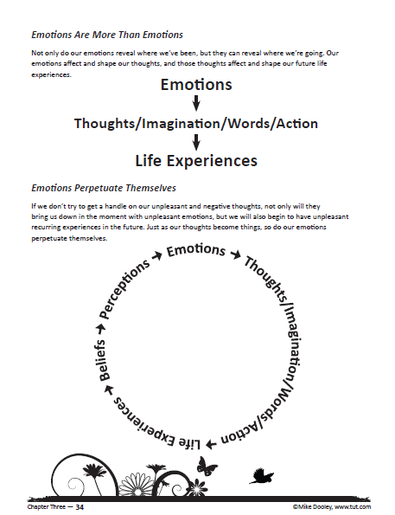









“Emotions Perpetuate
Themselves:
Going deeper & farther into the cycle of
Cause and Effect”
➔

Slide 35
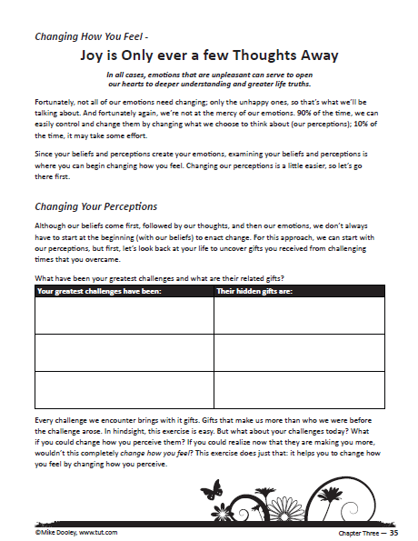



2 Ways to
FEEL BETTER
1st ➔
Let’s do this:
Share in a
Breakout Group➔

Slide 36
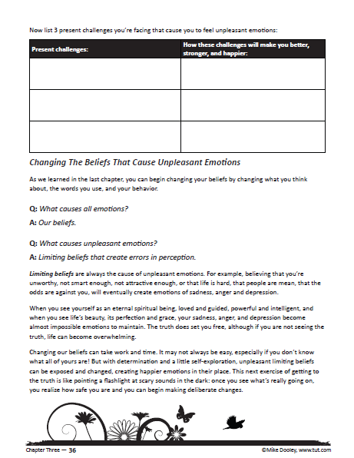


2 Ways to
FEEL BETTER:
2nd Way ➔

Slide 37
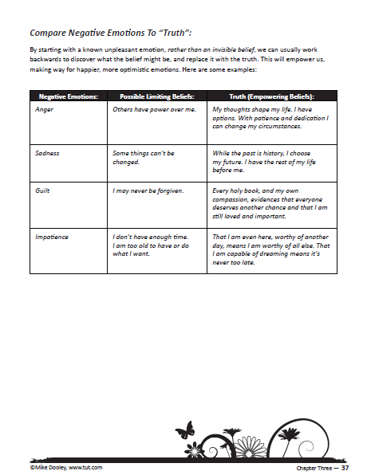




1 - Feel the Emotion
2 - Find the Limiting Belief
3 – FLIP for Solution!
➔

Slide 38
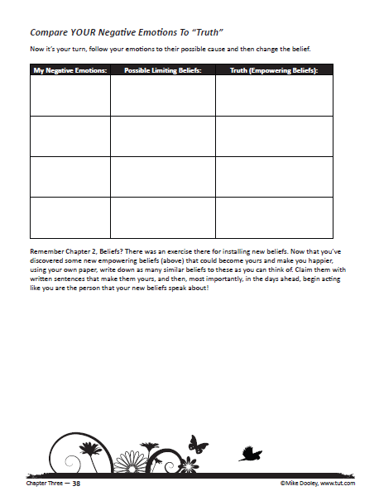

Unpleasant emotions lately?
Possible limiting beliefs?
Opposite belief/truth?
➔

Slide 39
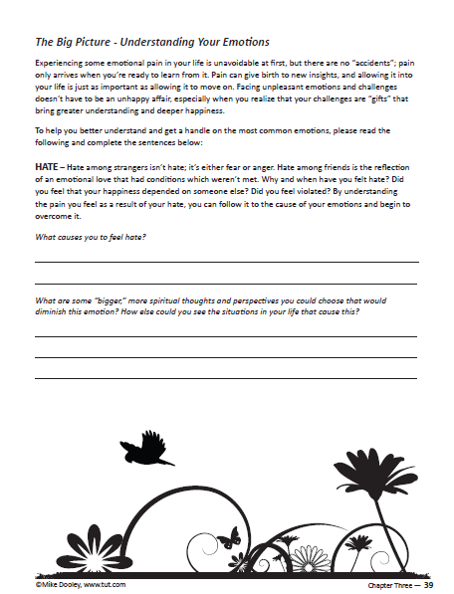


Going deeper into the Cause and Effect
of Emotions…

Slide 40
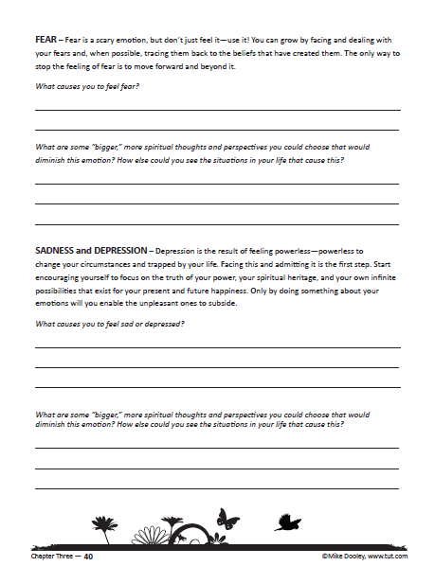






Going deeper into Cause and Effect
of Emotions…

Slide 41
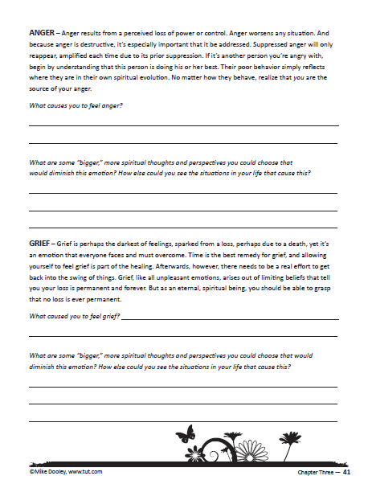










Going deeper into Cause and Effect
of Emotions…

Slide 42
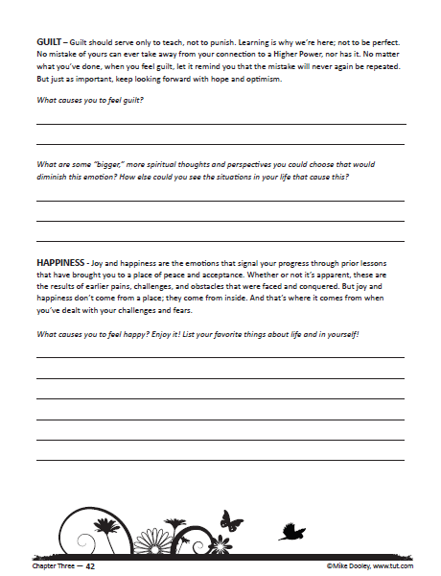




Going deeper into Cause and Effect
of Emotions…

Slide 43


Homework:
“Monitor your feelings and understand their source. Then change those that are displeasing…”

Slide 44


Slide 45
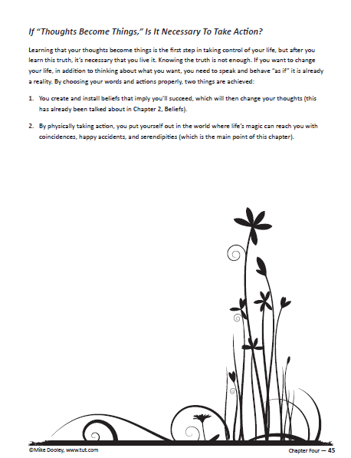

“Maybe begin a session with a powerful
question…”
YES! Times 2!

Slide 46
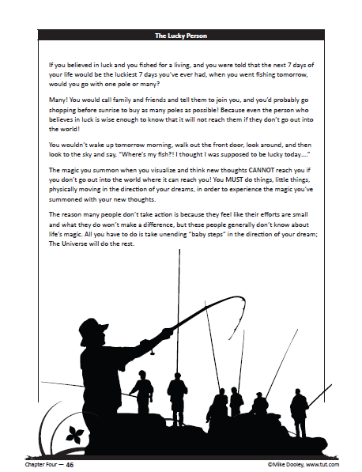

The
“Lucky Person” parable:
➔

Slide 47
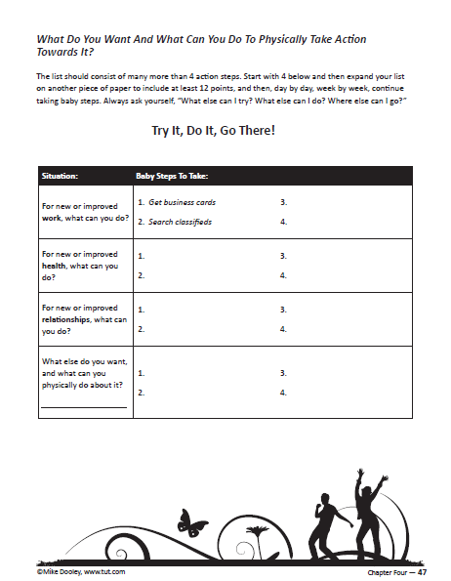





“Baby steps are simply what your peers are doing.”
Ask your audience to
shout out some ideas ➔

Slide 48
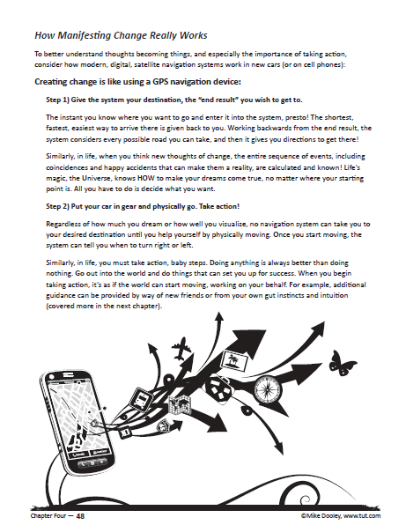





The “G.P.S.” Analogy
is solid gold ➔
“All change begins with the “End Result” in mind (in thought).”

Slide 49
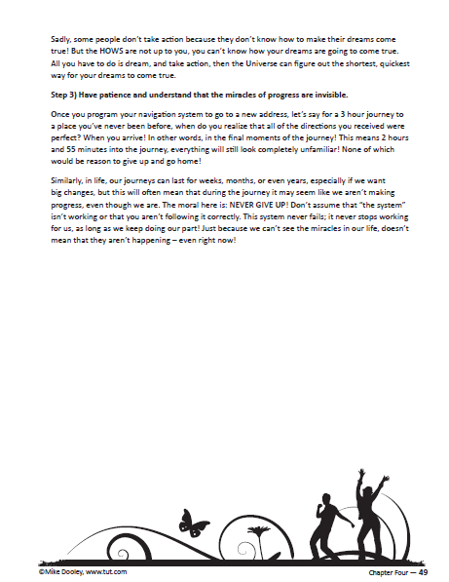
G.P.S. continued ➔
Secret Code:
G.P.S.

Slide 50
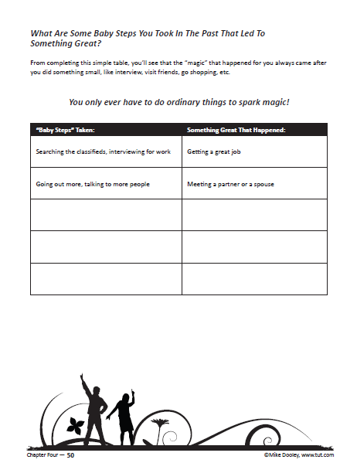



Ask more questions… ➔

Slide 51
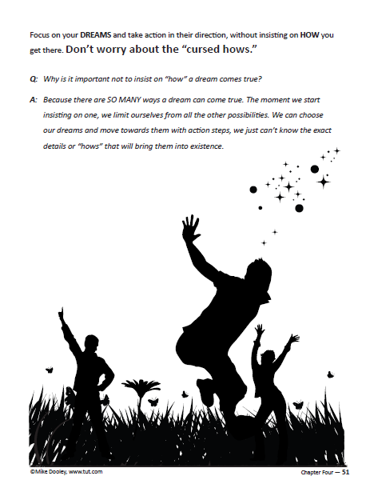
The “Cursed Hows”:
“When we insist on one “HOW” we shut the door on all others!”

Slide 52
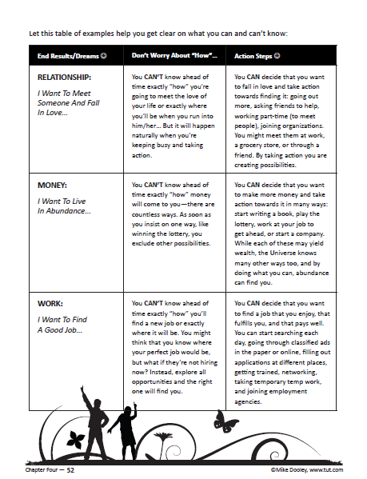













But… just because
we CAN’T
know the HOWS, doesn’t mean we can’t get busy.
Notes:
After each Action step read in 3rd column, add, “and you can know that among 7.5 billion people someone is out there waiting for you!”

Slide 53
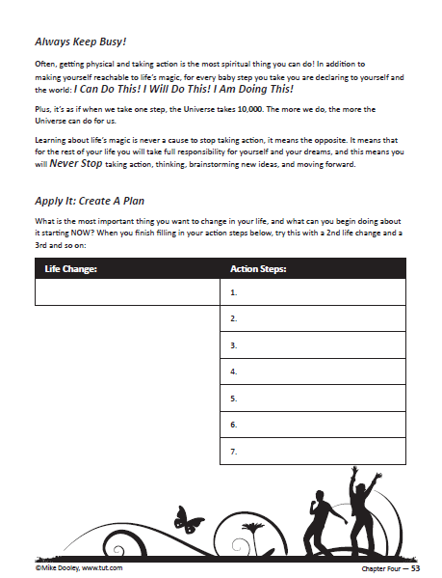

LET’S DO THIS:
Write a desired End Result.
(maybe as a Certified Trainer)
3 things you can do about it;
Commit now.
Share in your
Breakout Group➔

Slide 54
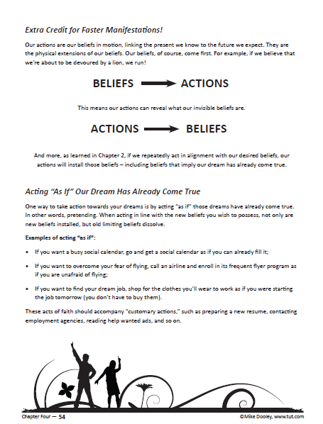





If:
Then:
Demonstrations
and Acting As-If…

Slide 55
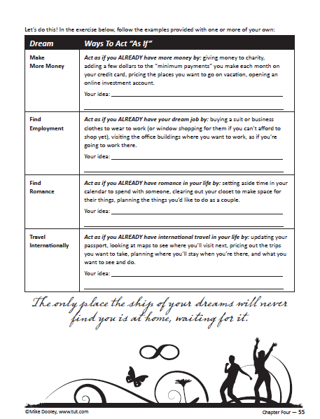






“Pretending and
Playing Make-Belief…”
Pick one category to the
right and add your ideas…
Notes:
Tell the Sir Anthony Hopkins story…

Slide 56

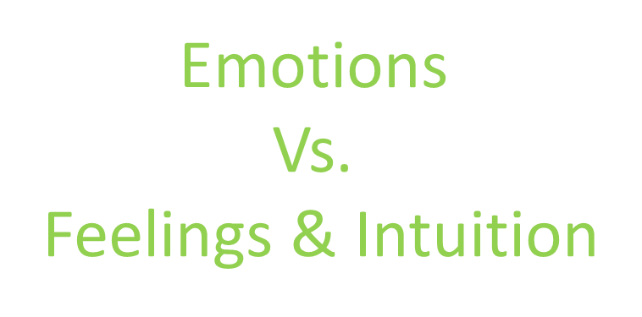

Slide 57
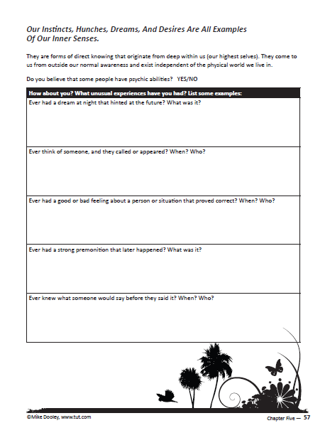





By a show of
Zoom Hands
Have you ever…….

Slide 58














“We all have a deep connection to a Higher Self. Once we realize it exists, we can deliberately use it!
“We are of God, by God, pure God! Connected to everyone, everywhere, always.”
Our Pipeline
to SOURCE!

Slide 59

If your Instincts and Hunches have helped you before…
What is ONE telling
you TODAY (in chat)?

Slide 60










Understand your dreams by understanding what
they promise…
Ideally, they promise:
Short & Long Term gains
Fun & Happiness for all

Slide 61


“Selfishness”
is in the eyes of the beholder…
Who else will benefit
from your dream?
Notes:
True selfishness automatically takes into account other people,
While at the same time giving your life, creativity and expression direction.
Win – win – win!

Slide 62

Conventional Wisdom
Homework:
Practice using your intuition in the days ahead.
Notes:
Homework: tell them how to go within and ask yes or no (as you did with marrying Marisol)

Slide 63


Slide 64





“Faith is trusting what you can’t see. But we’re not talking about Blind Faith, but a rock-solid faith rooted in:
Experience or Understanding.”
Notes:
NOT A RELIGIOUS THING!!!!!!!!!!!!!!!

Slide 65



Experientially
Write down 3 dreams of yours that have already come true.
2) Now list 3 present dreams you have for the future.

Slide 66



Experientially
Combine your lists from the previous page, alternating entries, AND for the future dreams write in the past tense! ➔
Notes:
Post this list on bathroom mirrors!

Slide 67

Understanding =
Logic + Intuition
Immerse yourself in truth to bolster faith. Counter the world and its attempts to keep you in a little box. Find, read, explore, ask, help, teach and never stop learning. ➔

Slide 68

Continued
Recommended
Reading
“What favorites of yours
have I missed?
Post in Chat now!”

Slide 69



Talking about “God” is at your own discretion.
Notes:
Yikes!! Optional!! Never easy….
Quickly mention this page, but then skip to next.

Slide 70


“Ask your audience for definitions of God, and/or, find
common ground…
“Whatever you believe, all would agree we each have a responsibility to ask and think for ourselves!!”
Connecting dots➔
THRIVE!

Slide 71









HOMEWORK:
Expect miracles and
see God in everyone…

Slide 72

Secret Code:
ADVENTURE
Shout out in Chat: ➔
“The top 3 reasons why you think WE are here on earth…”

Slide 73




“All answers are respected, now let’s look to see ‘what is,’ in the most general sense, to make this less theoretical” ➔

Slide 74











Simplified ➔
Adventure leads to Learning… Learning leads to Adventure…
Adventure leads to Learning…
In short…
We are here to LIVE our lives!

Slide 75


75
“How about YOU,
WHY do you think you’re here? What do you most LOVE? And, what seems to be the main lesson(s) of your life right now?”
Share in your
Breakout Group➔

Slide 76




Getting a little
old school… ➔

Slide 77


If you could make
ONE WISH
What would you wish?

Slide 78

Challenge yourself
and your students to
continue learning and
applying everything shared.
“Programs don’t change lives, people do; we do!
And YOU will!”
Tonight, write yourself a letter to keep as a reminder of your key take-aways.

Slide 79

My Take-Aways for
each of you:
You are of God, by God, pure God.
Your Thoughts Become Things.
You were born to succeed.
The End ☺

Slide 80


Slide 81

A Note from the Universe...
It was perhaps one of your greatest acts of love…
Choosing to be alive at a time when so many live so
deeply in the dark.
And already things are looking brighter.
All bow,
The Universe
P.S. Your finest hour. And mine, too.

Slide 82


Philosophy & concerns
Key questions & considerations

Slide 83
What?
Keep it Simple...
Let your premise be that the world
does not need to be saved...
  We needn’t proselytize or preach – too many people are. hungry for the truth to spend time with those who aren’t
  Teaching and learning is just an option.
  If it’s ever not fun, take a time out or let it go.
  Keep in mind that teaching is the best way to learn.
Notes:
The following slides show several examples of timelines using SmartArt graphics.
Include a timeline for the project, clearly marking milestones, important dates, and highlight where the project is now.

Slide 84

What?
Keep it Simple...
Using the Book
It defines our work, gives us
credibility, and helps open doors.
It must be read by Trainers.
Not required of trainees.
Does not have to be used in “class.”
Improvise – you don’t have to review every topic.
Notes:
The following slides show several examples of timelines using SmartArt graphics.
Include a timeline for the project, clearly marking milestones, important dates, and highlight where the project is now.

Slide 85
What?
Keep it Simple...
Using the Workbook
It too defines our work, gives us
credibility, and helps open doors.
Streamlined version of the book.
Sequence of lessons differs from book.
Also, not mandatory (see Quick Start Lessons).
It’s a guide, improvise.
Notes:
The following slides show several examples of timelines using SmartArt graphics.
Include a timeline for the project, clearly marking milestones, important dates, and highlight where the project is now.

Slide 86
When?
How does Monday sound?
Don’t take for granted what you already know.
Do your friends ask you for advice?
Ever been told you should write a book?
Field of Dreams: “Build it, and they will come.”
Speak and your audience will assemble.
Don’t judge your readiness by what you don’t know!
When “playing” the role of teacher, you’ll soon surprise.
yourself by how much you do know.
Start, and your “ducks” will line-up!
Notes:
The following slides show several examples of timelines using SmartArt graphics.
Include a timeline for the project, clearly marking milestones, important dates, and highlight where the project is now.

Slide 87
Q: Where will I begin?
Where?
Professionally
  Extension of present work.
  As the start of a new business.
At home.
At jails, churches, shelters, Meet-Ups, etc.
On-line, Bridge Calls, Blogging, etc.
Notes:
The following slides show several examples of timelines using SmartArt graphics.
Include a timeline for the project, clearly marking milestones, important dates, and highlight where the project is now.

Slide 88
How?
How will I start?
  Get to know the material (book, workbooks, exercises) – now!
  Use the tut.com IP TTT Resources!
  Say “Hello!” on Facebook and stay current with news, announcements, form releases, updates, shares, etc.
  ASK for help! Don’t go-it alone! Use Inner Circle Leaders!
  Prepare and practice, consider joining Toastmasters.org.
  Capitalize on our track record with other organizations, using TUT and this program to add to your credibility.
Notes:
The following slides show several examples of timelines using SmartArt graphics.
Include a timeline for the project, clearly marking milestones, important dates, and highlight where the project is now.

Slide 89
YIKES?
Tricky Questions –
Hitler, AIDS, Child Abuse...
    What matters are the lives of your trainees, today.
    “I don’t know.” Is always a respectable answer.
    Toss question back to questioner or audience.
    Spirituality versus Religion.
    God versus the Universe versus Higher Self/Power.
    Resistance may be greater in prisons, etc.
    AA and NA... Feeling defeated?
    The 12 Step Programs – powerless or powerful?
Notes:
The following slides show several examples of timelines using SmartArt graphics.
Include a timeline for the project, clearly marking milestones, important dates, and highlight where the project is now.

Slide 90



Beyond “TRAILBLAZER”
Beyond
TRAINING
CERTIFICATION

Slide 91


Slide 92
A Guided Visualization
Imagine you’re at the beach… You’re sitting on a veranda attached to a magniﬁcent beach house and right now you can hear the surf crashing ... You can smell the salt in the air ... and you can hear the occasional seagull calling out to others ... The sun is setting, and you’ve got a huge smile on your face. Go ahead and smile. You’re beaming with joy because the house behind you is ﬁlled with all of the people you love the most. You’re feeling so much joy that a tear trickles down your face as you relish why these dear friends have gathered. Each is there because they love you ... as much as you love them. And they’re there to help you celebrate all of the fantastic changes that have been sweeping through your life. Changes that have shocked and amazed you, as much as them, with their speed and harmony.

Slide 93
Deeply grateful, you make a promise to yourself while still
sitting on the veranda that never again, for the rest of your life,
will you ever let yourself forget how swiftly things can change for
the better! Right now, it’s as if, in your life, every cup is overﬂowing: there’s abundance, you love your life, you love your work, you’re creatively fulﬁlled. You’ve never had so many friends, and you’ve never laughed so hard. Virtually everything you’ve ever wished for has come to pass ……... With one tiny exception—there’s one cup not yet overﬂowing.
The one thing now missing in your life has come in the form of a brand-new desire. You now wish with every ﬁber of your body to impart the joy you’re feeling—the fulﬁllment and the love—to all those you so love. And not stopping there, you wish you could give these feelings to everyone in the world. Everyone on planet Earth should feel as good as you now feel, should be as loved as you are now loved, should have as much going on in their life and as many dreams coming true as you now have in your life. But you can’t. You feel limited. Brieﬂy disappointed to the point of losing your smile …….. until suddenly, as if struck by lightning, spontaneous illumination arrives and you remember that it was not that long ago when you were bobbing high and low in the troughs of life.

Slide 94
When you were frustrated, when you were spinning your
wheels. Yet, it’s now obvious to you that your place on the
veranda, right here and now, with this joy you’ve been feeling was always ... inevitable. And suddenly, there’s another ﬂash of insight! Now you realize that you needed to go through all you went through, everything in your life, to be at this magniﬁcent place of realization and deep understanding. And you see that just as it was ultimately inevitable for you to get to this point, so is this true for all of those you love and for everyone now on Earth. This realization overwhelms you with its sublime implications, and another tear rolls down your cheek.
You’re overcome with a joy you have never felt before. You’re overcome with acceptance and love for all that is, exactly as it is now. Blissfully content, and feeling that your life could not possibly get any better than this ... suddenly, again, you experience one more gigantic ﬂash of illumination that nearly knocks you out of your chair ... As good as life now is, as joyful as you now feel, it has suddenly dawned on you that forever and ever and evermore, things will only get better ... Whoo-hoo, you have arrived! The promise has been delivered, your birthright accepted, and thy personalized KingQueendom has come!

Slide 95


QUICK START...
One Page Template
Page 9 of
Trainer’s Guide

Slide 96
Becoming a trailblazer
And Possible training trajectories
Notes:
Information is on the conference page.

Slide 97
Main IPPIE DESIGNATIONS
Certified IP Trainer
Trailblazer
Matrix Certified
Specialty (e.g. IBIM, Corporate Continuum, etc.)

Slide 98
Trailblazer DESIGNATION
The “GOAL”:
Deliver the IP Program* one time,
To 6 people, over 6 hours,
Using the workbook.
* The Workbook or Adapted Lessons (p.65)

Slide 99
KEY POINTS OF IP Program
  Both the Workbook and Adapted Lessons
  aim to convey 3 KEY TEACHING POINTS from each chapter – See Trainer’s Guide,
  Page 32 and 33!
  Know what they are before you put together your plan ☺

Slide 100
Content Formulation
Possible Evolution of your Lesson Plans...
IP Workbook
Trainer's Guide
Adaptive Lessons
Radical Forgiveness, or other combo
Life
Coaching
& Speaking
“Your Way”
Alternatively......
Notes:
The following slides show several examples of timelines using SmartArt graphics.
Include a timeline for the project, clearly marking milestones, important dates, and highlight where the project is now.

Slide 101
OR...
IP Workbook or
Adaptive Lessons
Life
Coaching
& Speaking
“Your Way”
Notes:
The following slides show several examples of timelines using SmartArt graphics.
Include a timeline for the project, clearly marking milestones, important dates, and highlight where the project is now.

Slide 102

Trainer's Guide, Page 31
How to EASILY Organize Any Single Lesson Plan
Deliver!
Notes:
Duplicate this slide as necessary if there is more than one issue.
This and related slides can be moved to the appendix or hidden if necessary.

Slide 103
7 Point Lesson Plan Template
One Meeting at a Time!
One minute intro of topic.
Ask a relevant/easy question.
Explain the question/answer.
Tell a story of relevance.
Direct Teach Key Points , p.32
(see Trainer's Guide),
integrating an exercise.
Summarize Key Points.
Offer challenge:
“Activation Homework”
DONE!
How to EASILY Organize Any Single Lesson Plan
Deliver!
Notes:
Duplicate this slide as necessary if there is more than one issue.
This and related slides can be moved to the appendix or hidden if necessary.

Slide 104
Trainer's Guide, Page 31
How to EASILY Organize Any Single Lesson Plan
Deliver!
Notes:
Duplicate this slide as necessary if there is more than one issue.
This and related slides can be moved to the appendix or hidden if necessary.

Slide 105


JUST FOR IPPIES!
HAY HOUSE Online Video Course, for LIFE!
$900 OFF for IPPIES…..only $99
hayhouseu.com/trainer
Notes:
What is the project about?
Define the goal of this project
Is it similar to projects in the past or is it a new effort?
Define the scope of this project
Is it an independent project or is it related to other projects?
* Note that this slide is not necessary for weekly status meetings

Slide 106

Trailblazer Master Class
Personalized, optional support to help you get started!
$90 for 90 Days of Mentoring
Private Facebook Community
Trailblazer give weekly FB LIVE lessons
Ask personalized questions, get immediate answers
Like having your own personal IP coach!

Slide 107



Slide 108


Slide 109
A Note from the Universe...
To clarify "eternal" just a smidge...
Once the river of time has rounded her final bend, and the last star in the sky has brightened its last night, and every child who may ever be conceived has been given ten thousand names...
…We will have just begun.
Got time?
The Universe

Slide 110
Certification conference
Notes:
This is the program I delivered in the prisons, it is what you may loosely follow.

Slide 111
Workbook Review
A Replicable program
Please have a journal, or note paper, and a pen available for this workbook review ☺
Notes:
This is the program I delivered in the prison, it is what you may loosely follow.

Slide 112


Slide 114


Slide 115

Teaching from the workbook…
Session 1
8 Possible Chapters and/or
Sessions
Sessions 2-8

Slide 116

(1st Session may begin here…)
Free-style the first meeting…
Introduce course,
Introduce yourself,
Introduce Mike Dooley

Slide 117



Free-style the first meeting…

